Slide 1

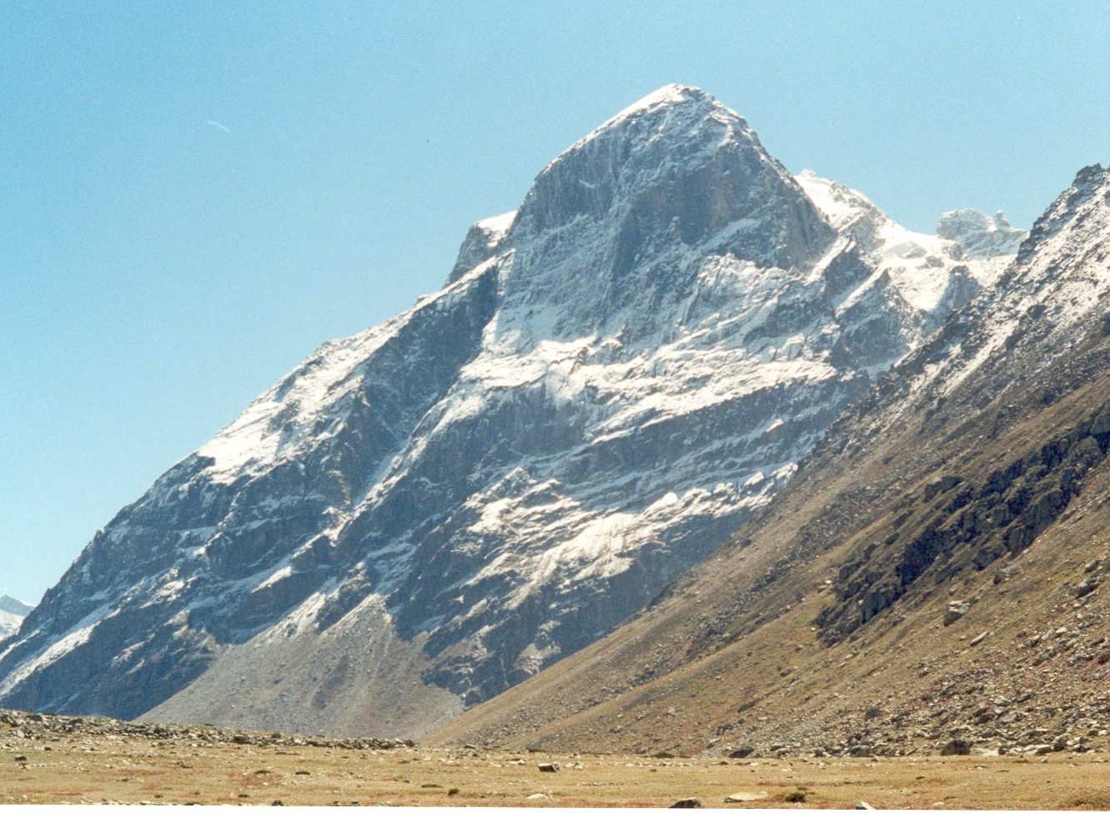

OBSERVED CHANGES IN HIMALAYAN CRYOSPHERE
ANIL V. KULKARNI
DISTINGUISHED VISITING SCIENTIST
DIVECHA CENTRE FOR CLIMATE CHANGE
INDIAN INSTITUTE OF SCIENCE
BANGALORE 560012 INDIA

Slide 2
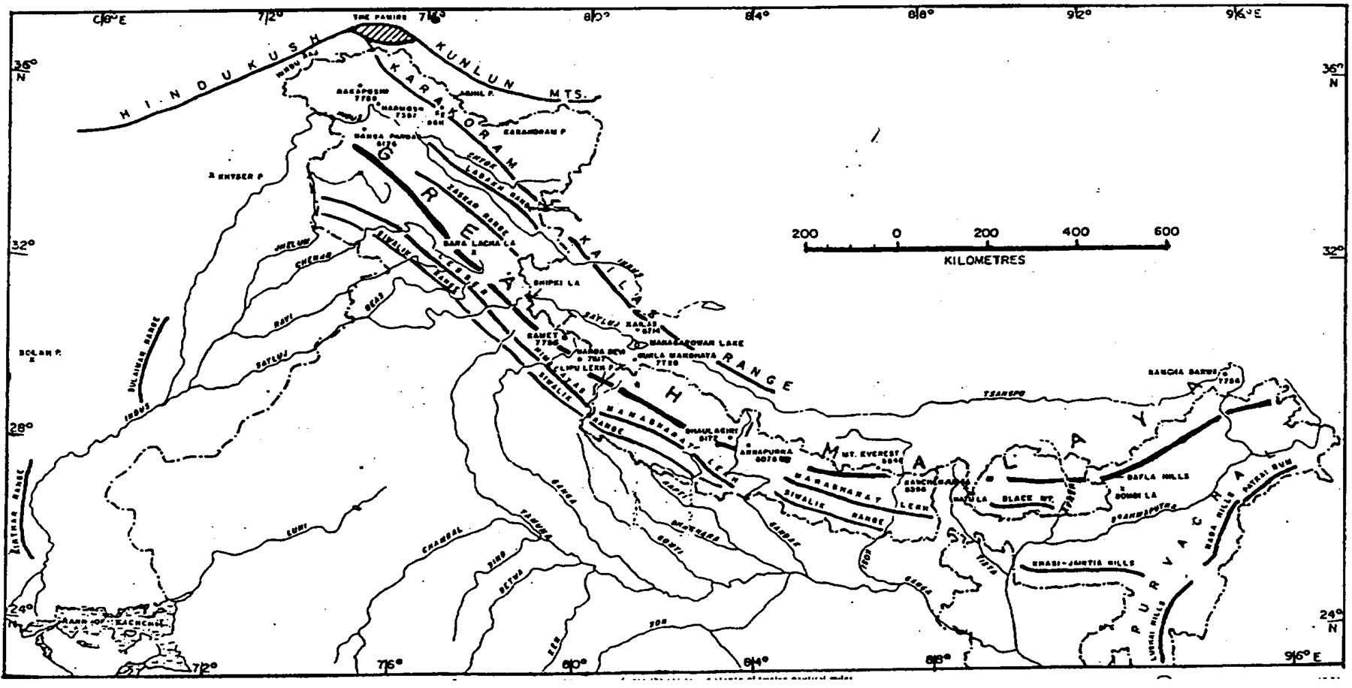
The Himalaya
Zanskar Range
Karakoram Range
North-West
Himalaya
THE HIMALYA
Ladakh Range
Pir Panjal Range
Great Himalayan Range
Central
Himalaya
Eastern
Himalaya

Slide 3
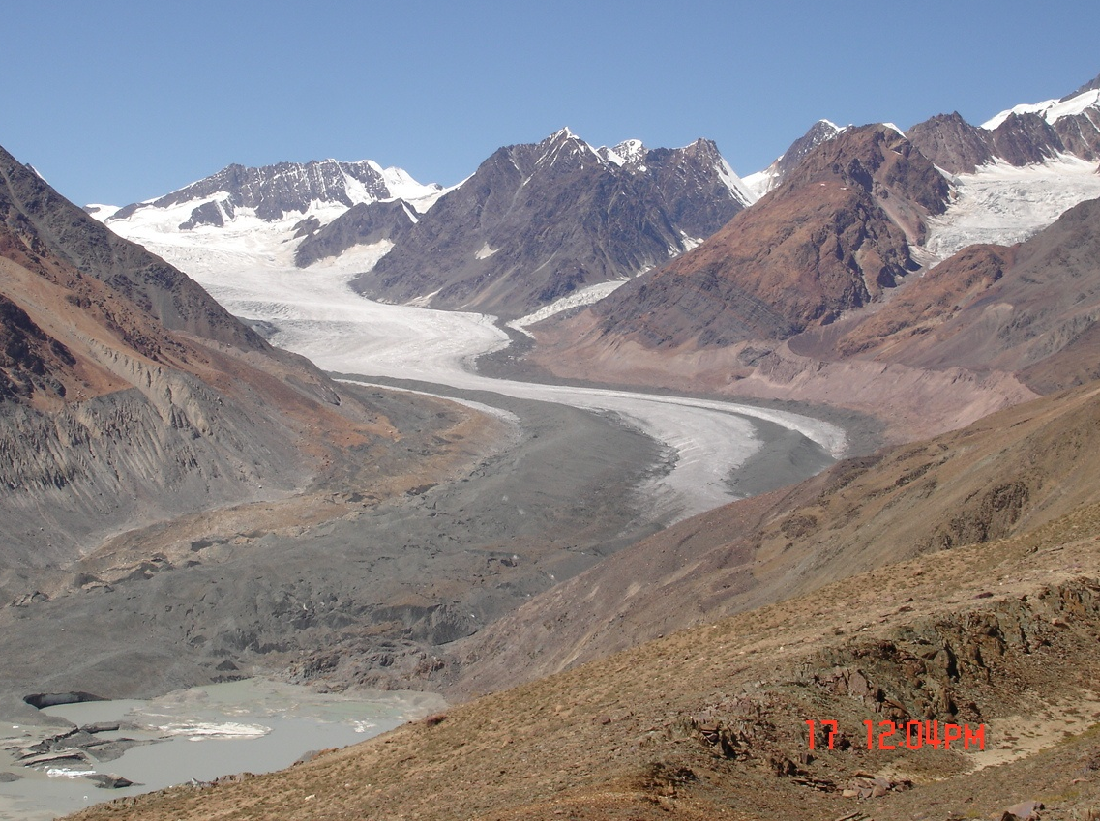
GEOMORPHOLOGY OF HIMALAYAN GLACIERS: SAMUDRA TAPU GLACIER, H.P., INDIA
Accumulation
area
Tributary
glacier
Moraine
Ablation area
Moraine-dammed
lake

Slide 4
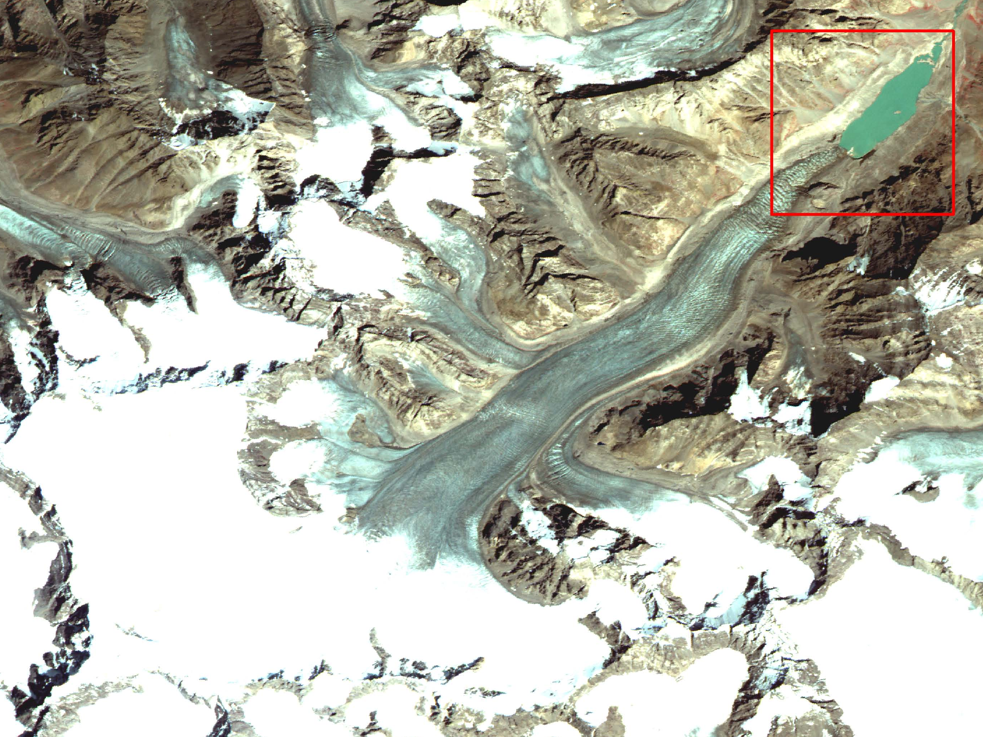
GLACIER FEATURES
lake
Snout
Lateral moraine
Tributary
glacier
Ablation
area
Accumulation
area
Snow line
IRS LISS IV
26 Aug. 2008
Zanskar basin
(J & K)
Glacier boundary

Slide 5
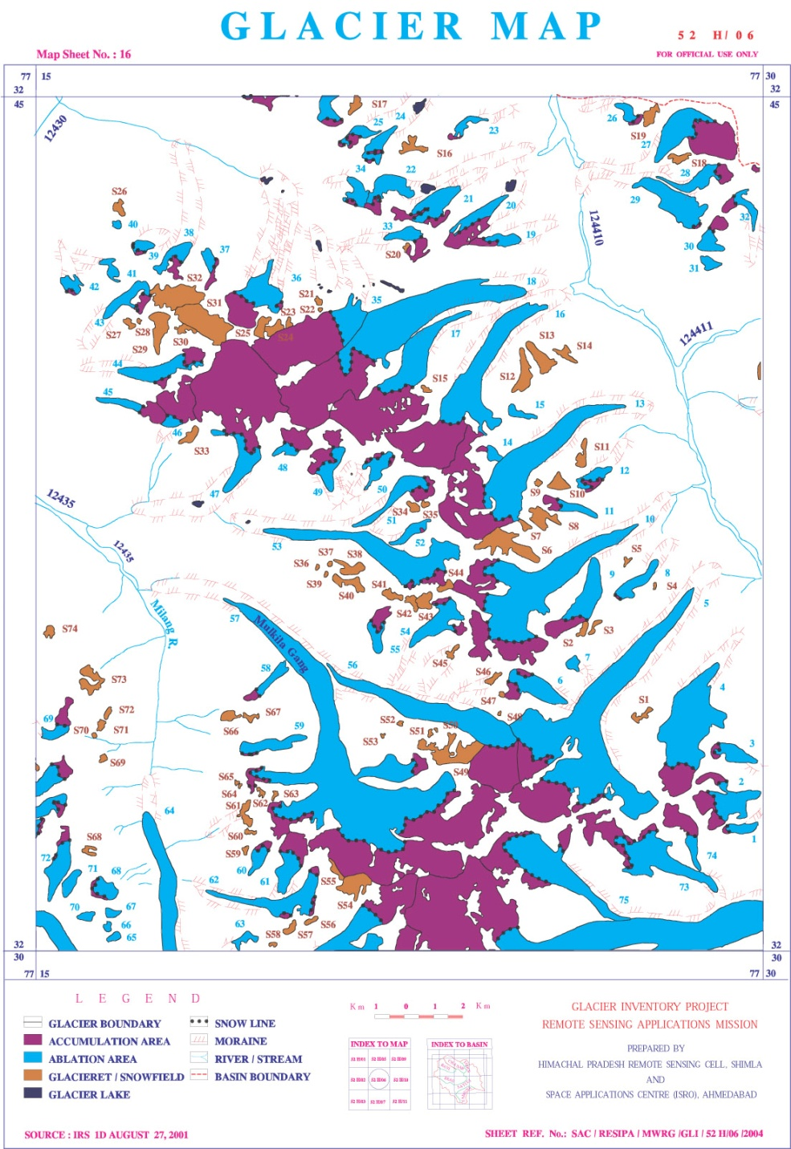
Glacier Inventory
INDIAN HIMALAYA
Scale | Mapping year | Areal extent (sq km) | Reference | comment
250,000 | 1988 | 23,300 | Kulkarni and Buch, 1991 | Glacierete and snow field not mapped
50,000 | Not available | 26,757 | Sangewar and Shukla, 2009 | Glacierete and snow field mapped
Basin | Year of mapping | Number of glaciers, glacieret and snowfield | Areal extent (sq km)
Satluj (H.P.) | 1993 | 2322 | 2697
Tista (Sikkim) | 1997 | 284 | 692
Dhauli Ganga (Uttarakhand) | 1996 | 108 | 229
Chenab (H.P.) | 2001 | 1186 | 1420
Total | ----- | 3900 | 5038

Slide 6
RETREAT OF GLACIERS IN INDIAN HIMALAYA
Pindari (1966-2007: GSI)
Samudra Tapu (1993-2000: SAC)
Hamta (1961-2005: GSI)
Dokriani Bamak (2004-2007: WIHG)
Gangotri (1976-1996: GSI)
Sara Umaga (1961-2005: GSI)
Parbati (1990-06: SAC)

Slide 7
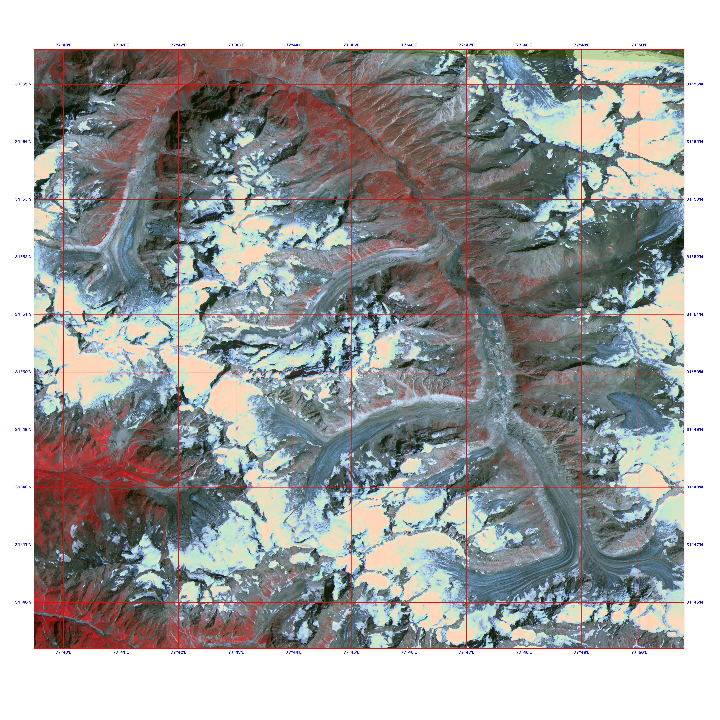
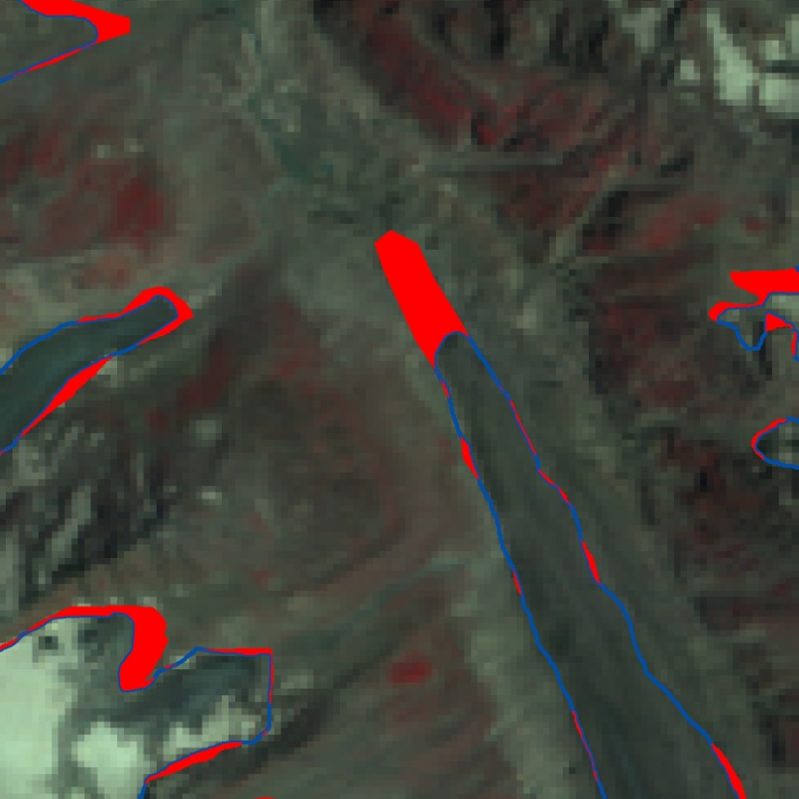
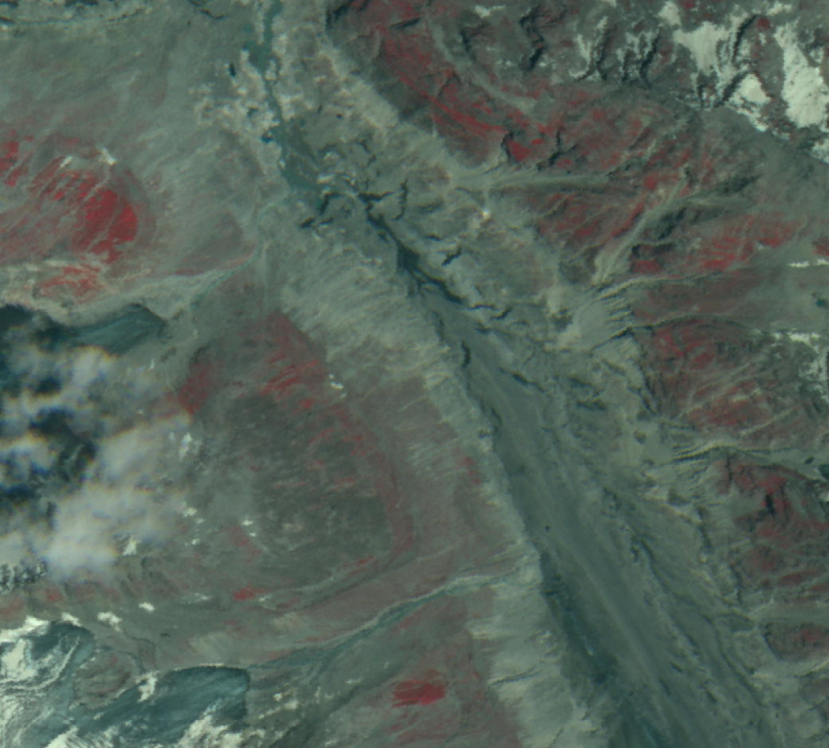
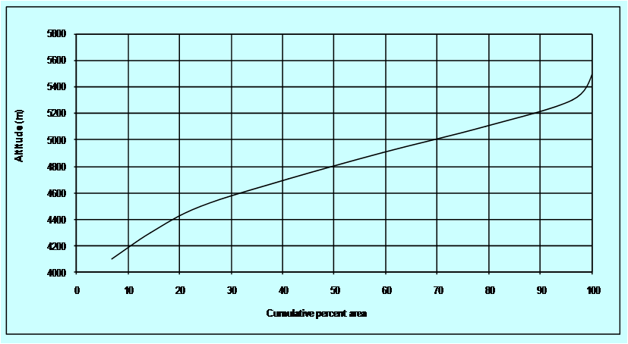
INFLUENCE OF ALTITUDE DISTRIBUTION RETREAT OF PARBATI GLACIER, INDIA
From: Kulkarni, 2005
;
LISS-III and PAN: 1998
LANDSAT TM: 2009
Dead ice zone
Loss in Glacial area
1998-2009
≈ 4 %
LISS-IV: 2004
AREA ALTITUDE DISTRIBUTION
Dead ice zone

Slide 8
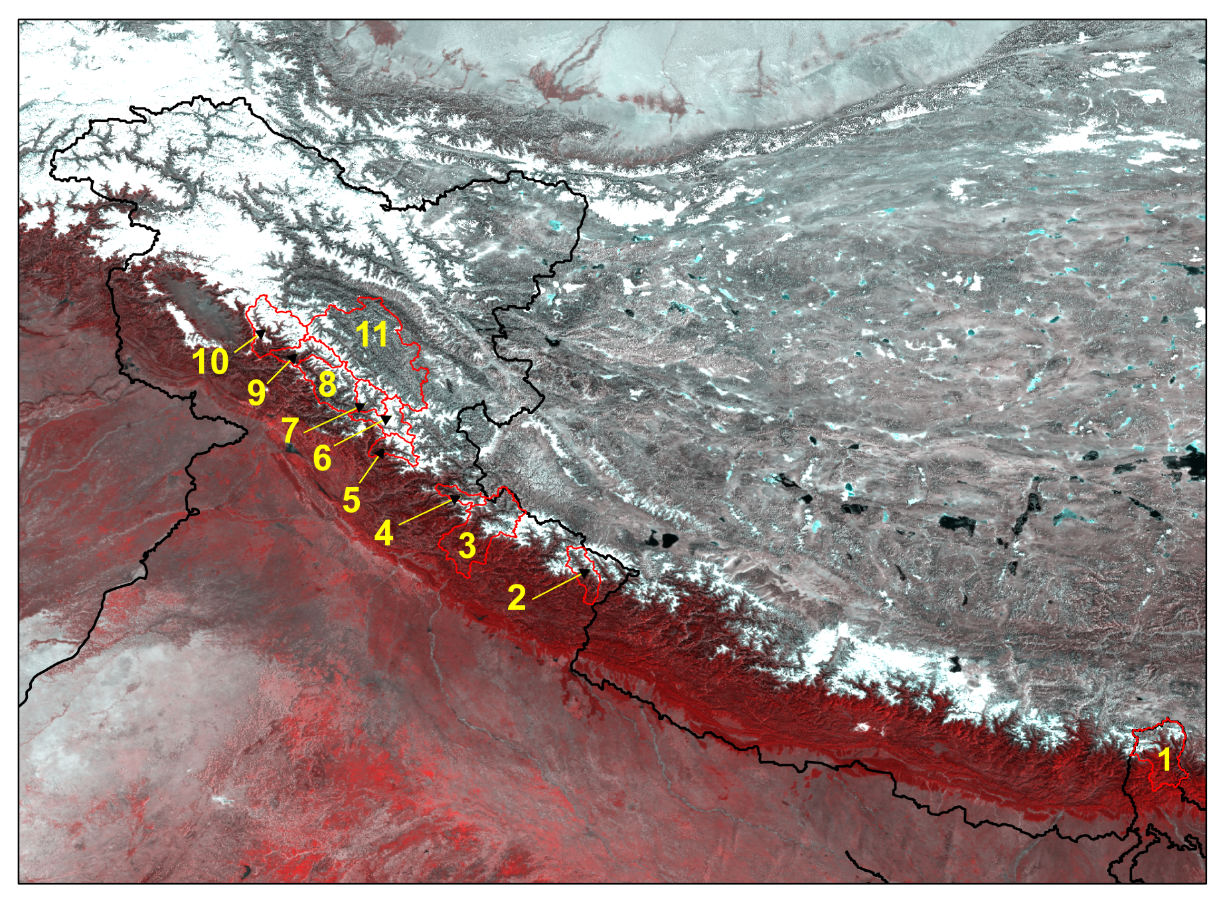
BASINS COVERED IN GLACIER RETREAT INVESTIGATION
(From Kulkarni et al., 2011)
1 Tista
2 Gori Ganga
3. Bhagrithi
4 Baspa
5 Parbati
6 Chandra
7 Bhaga
8 Miyar
9 Bhut
10 Warwan
11 Zanskar
CHINA
PAKISTHAN
INDIA
NEPAL

Slide 9
LOSS IN GLACIATED AREA IN HIND KUSH HIMALAYA
Region/basin | Period | Areal extent (km²⁾ | Change in area % | Reference
Mt. Everest, Nepal | 1976-2006 | 3212±0.019 | -15.63 | Yong et al,2010
Nyainqentanglha Range and the Nam Co Basin, Tibet | 1976-2009 | 207.1±7.2 | -9.9±3.1 | Bolch et al.,2010
Indus, India | 1962-2001/4 | 4632 | -16 | Kulkarni et al., 2011
Ganga,India | 1962-2001/4 | 1700 | -15 | Kulkarni et al., 2011
Tista, India | 1997-2004 | 403 | -2.7 | Kulkarni et al., 2011
Upper Bhagirathi and Saraswati, India | 1968-2006 | 599.9±15.6 | -4.6±2.8 | Bhambri et al., 2011

Slide 10
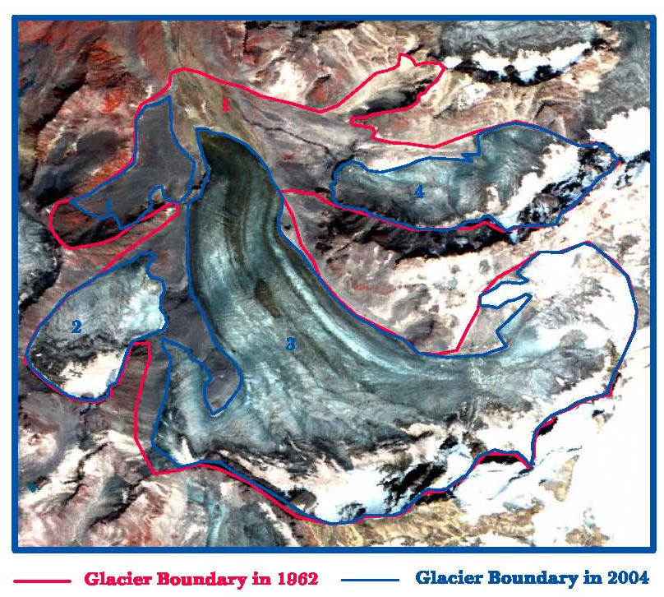
FRAGMENTATION OF GLACIERS (Kulkarni, et al., 2007)

Slide 11
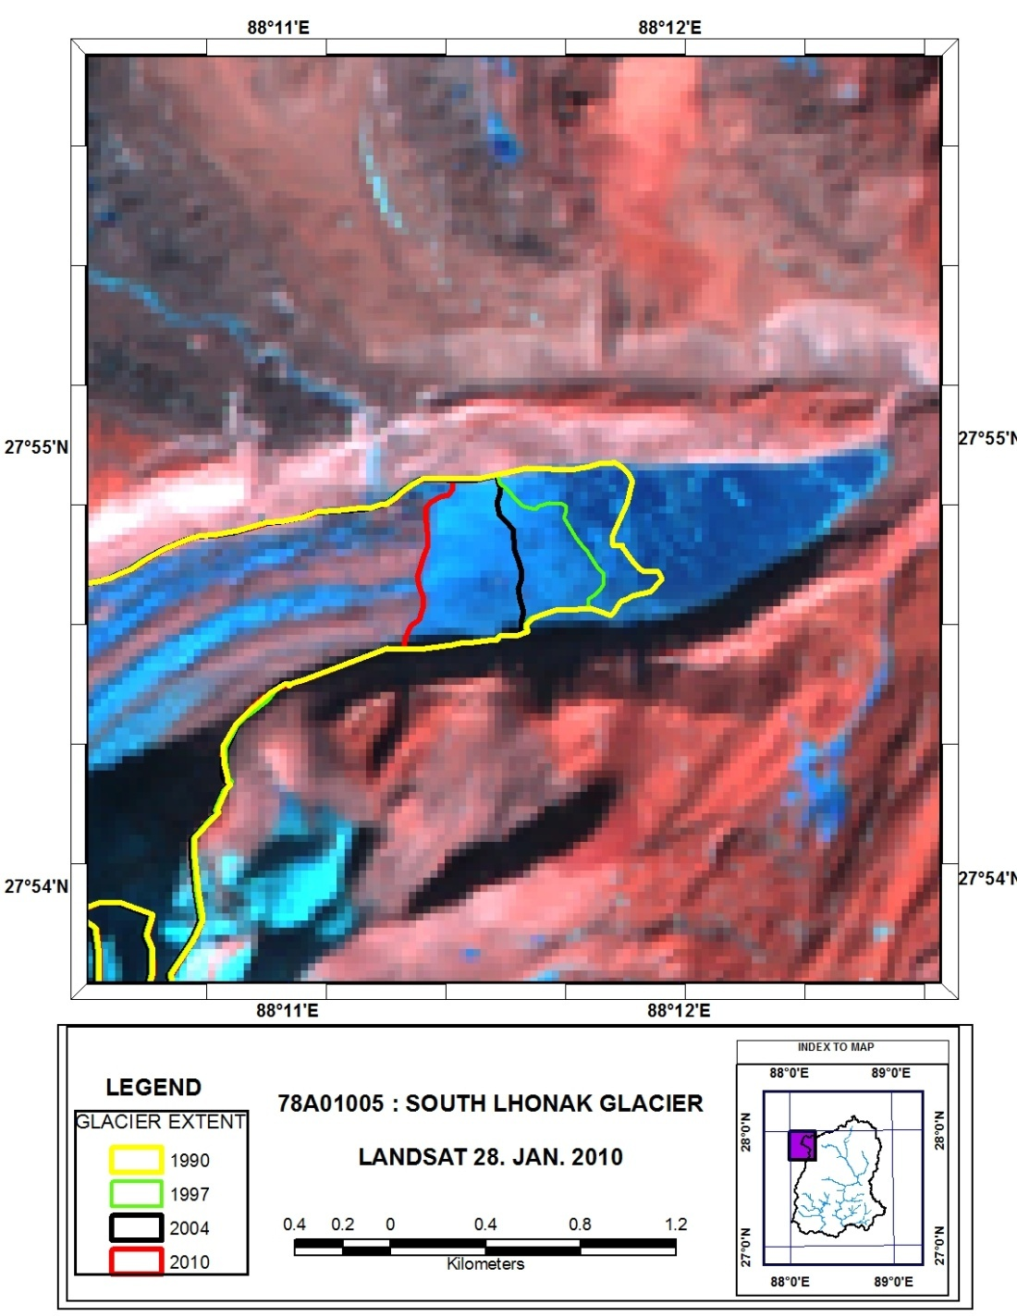
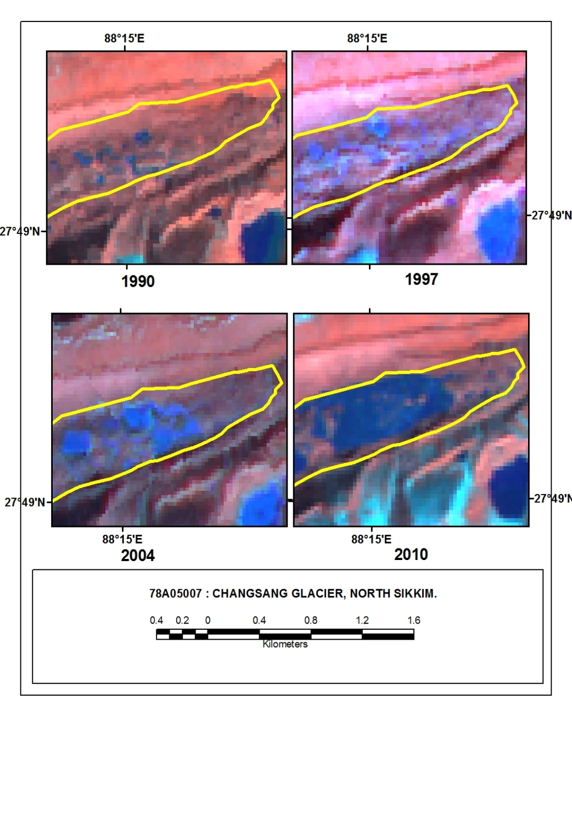
SIKKIM HIMALAYA
INFLUENCE OF MORAINE DAMMED LAKES ON RETREAT.

Slide 12

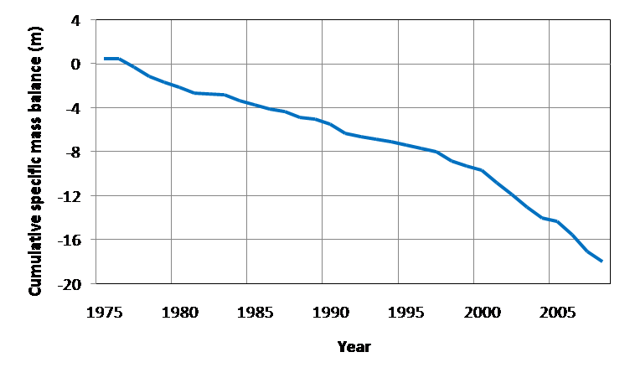
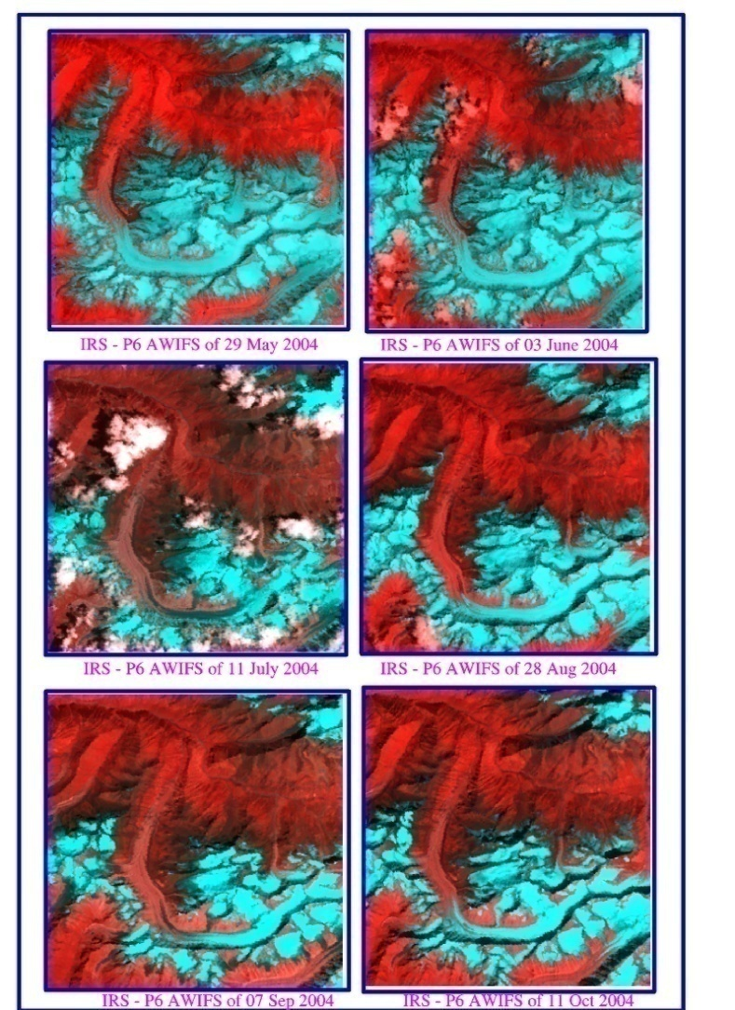
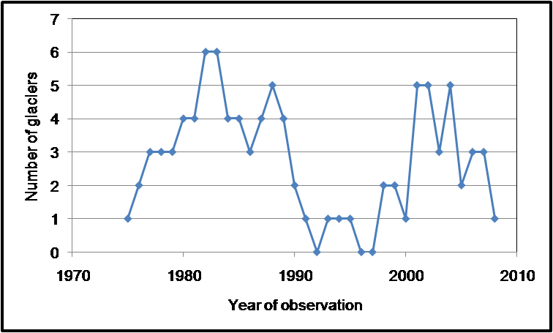
MASS BALANCE OF HIMALAYAN GLACIERS
Data gap from 1990 to 1997
Mean Mass balance
1978-88 -0.41 ± 0.24 m
1998-08 -0.91 ± 0.39 m

Slide 13
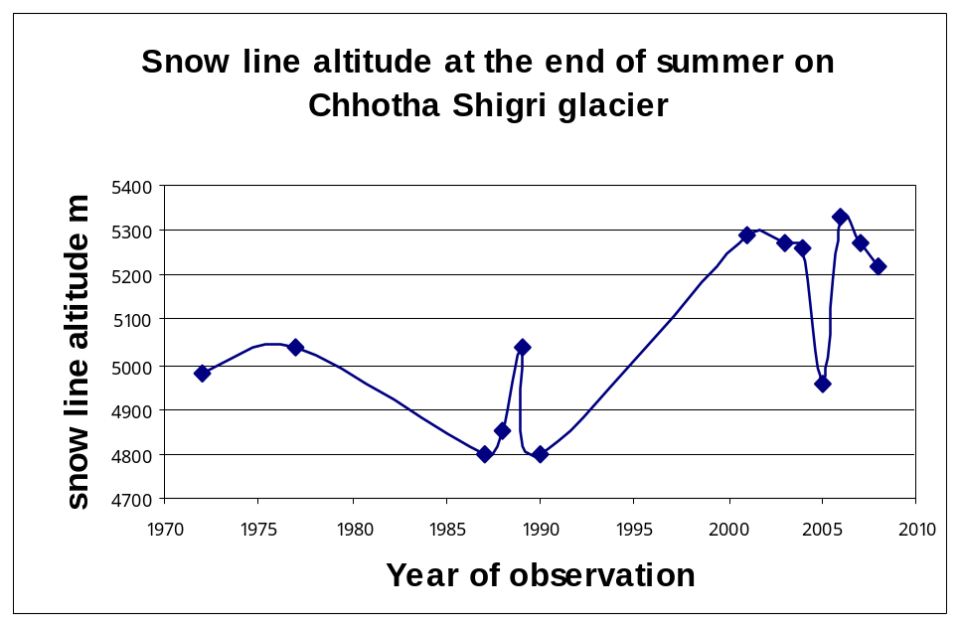
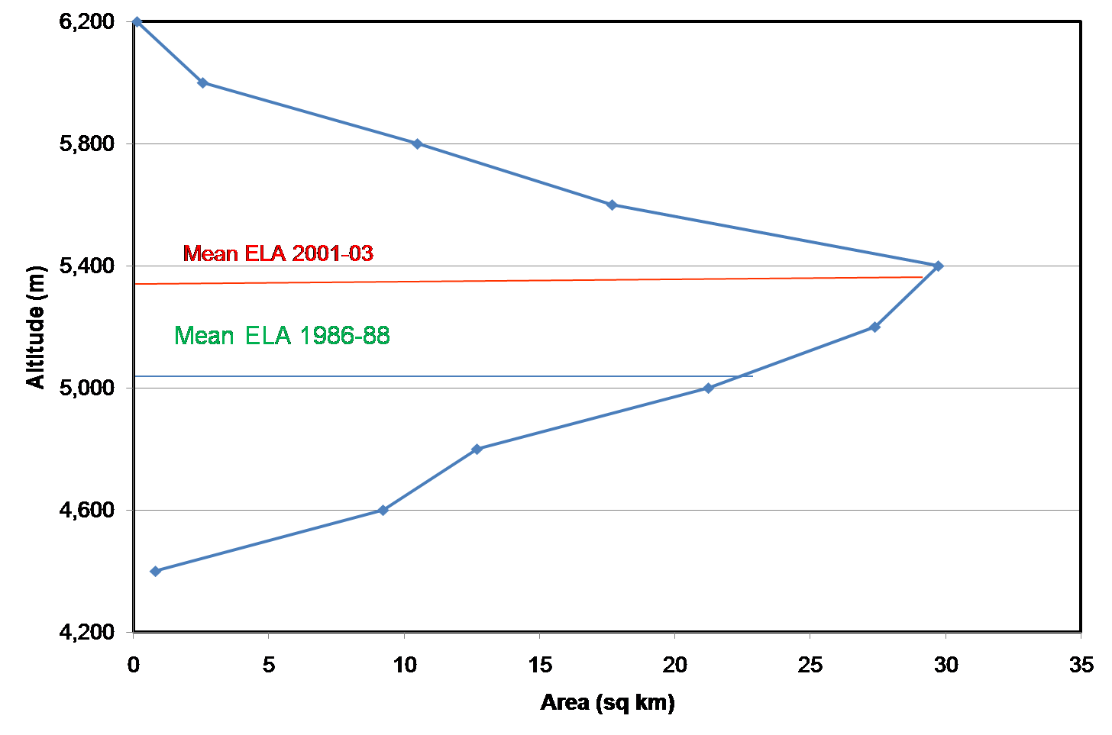
BASPA BASIN: CHANGE IN ELA
From: Kulkarni 1992, 2002 and 2011

Slide 14
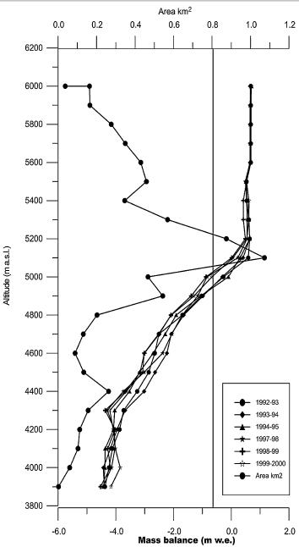
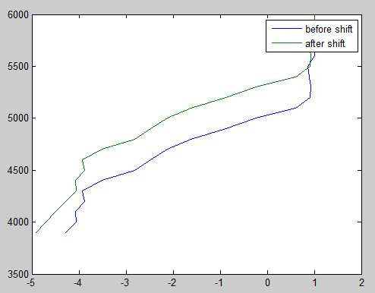
EFFECT OF 2 DEG RISE IN TEMP. ON MASS BALANCE
DOKARIANI BAMAK GLACIER
ELA | Sp. mass balance (m)
5065 | - 0.32
5300 | -1.12
If temperature rises by two deg C from present then negative mass balance will increase by factor of 3.5
From: Dobhal et al.,2008

Slide 15
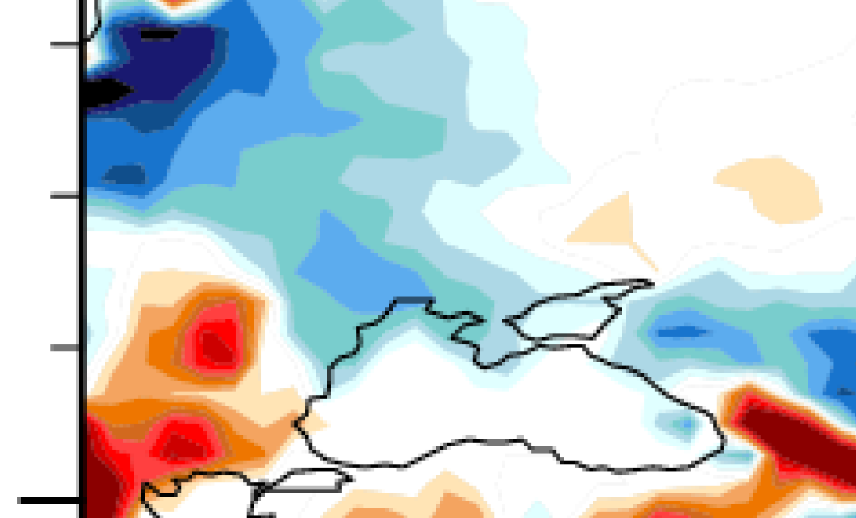
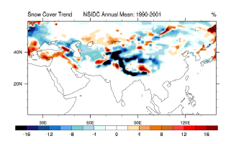
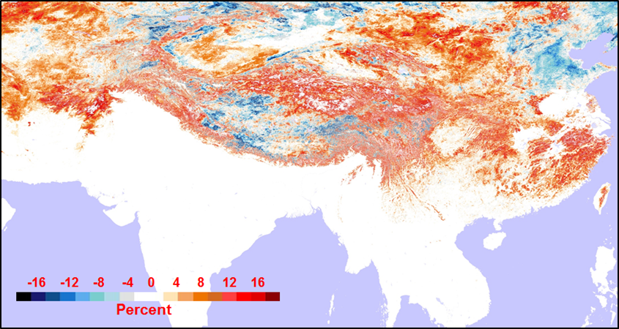
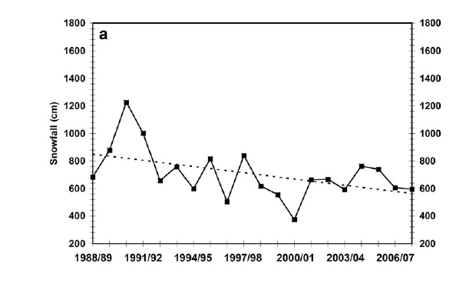
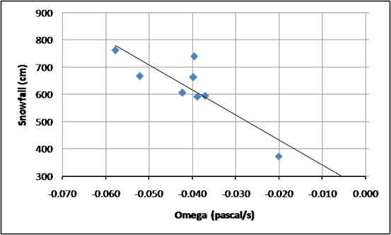
DECADAL CHANGES IN SEASONAL SNOW COVER
1990-2001 2001-2010
From: Menon et al., 2010
From: Gurung and Kulkarni et al., 2011
From: Shekhar et al.,2010

Slide 16
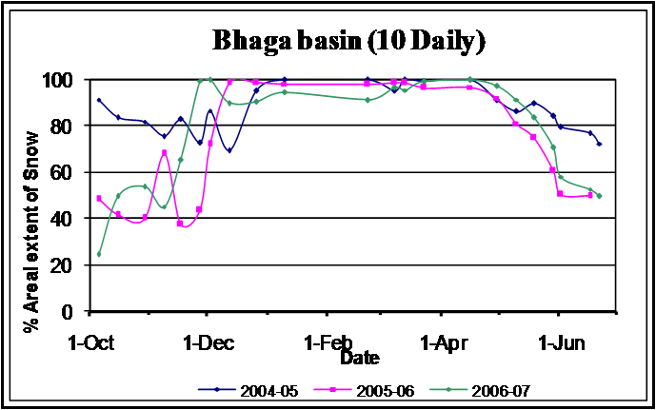
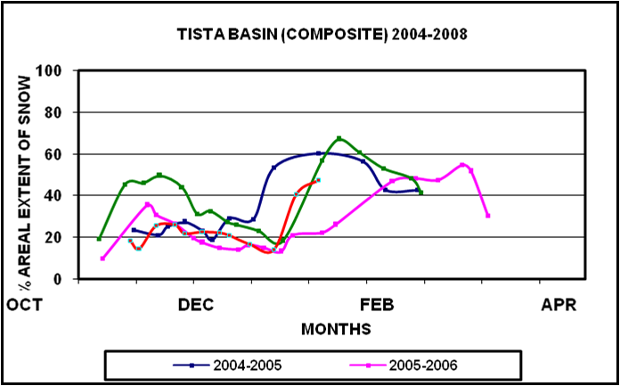
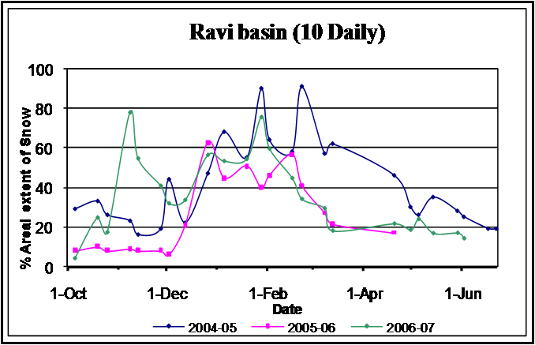
Snow accumulation and ablation pattern in basins
located in different parts of Himalaya
From: Kulkarni et al., 2010
Mean snow fall Western Himalaya: 2004-5: 739 cm; 2005-6: 606 cm; 2006-7: 596 cm

Slide 17
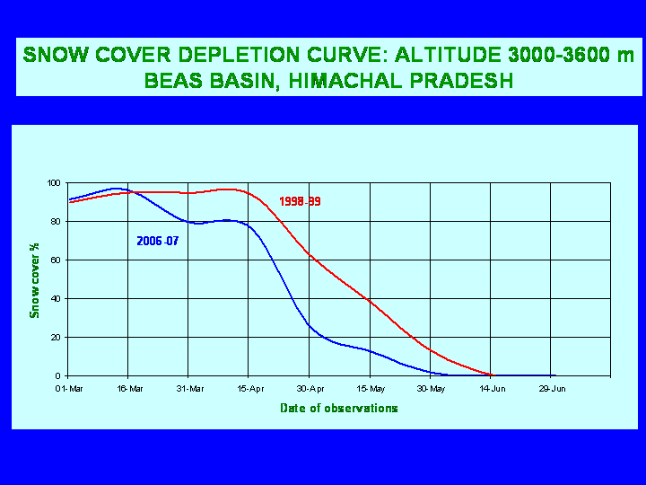
SNOW DEPLETION CURVE:BEAS BASIN
ALTITUDE 3000-3600 m
INCREASE IN STREAM
RUNOFF OF BASPA BASIN FOR DECEMBER BETWEEN 1966 TO 1993 IS FROM 8 TO 14 CUMECS
(Kulkarni et. al. 2002 and 2003)

Slide 18
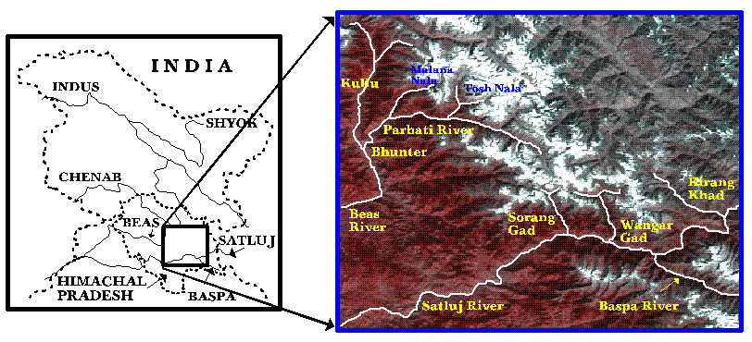
DEVELOPMENT OF SNOW AND GLACIER MELT RUNOFF
MODEL FOR MICRO AND MINI RIVER BASINS
(Kulkarni et. al. 2002)

Slide 19
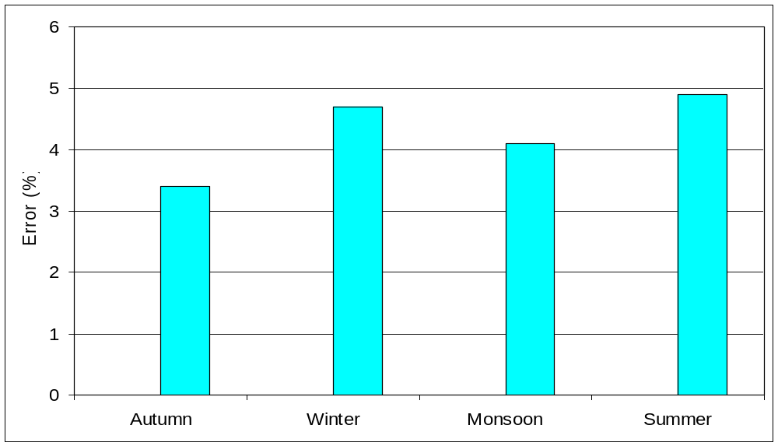
Validation of snow and glacier melt runoff model:
Wangar Gad basin
(Rathore and Kulkarni, 2009)
4.9 %
4.7 %
4.1 %
3.4 %

Slide 20
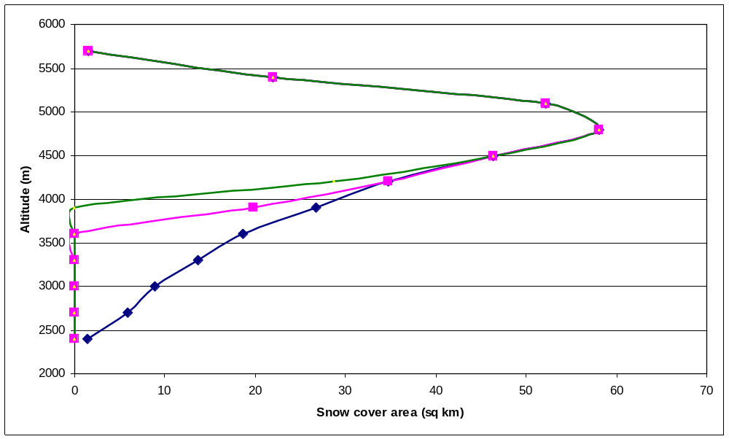
CHANGES IN SNOW COVER DUE TO RISE IN TEMP BY 1 DEG C
From: Kulkarni et al., 2010

Slide 21
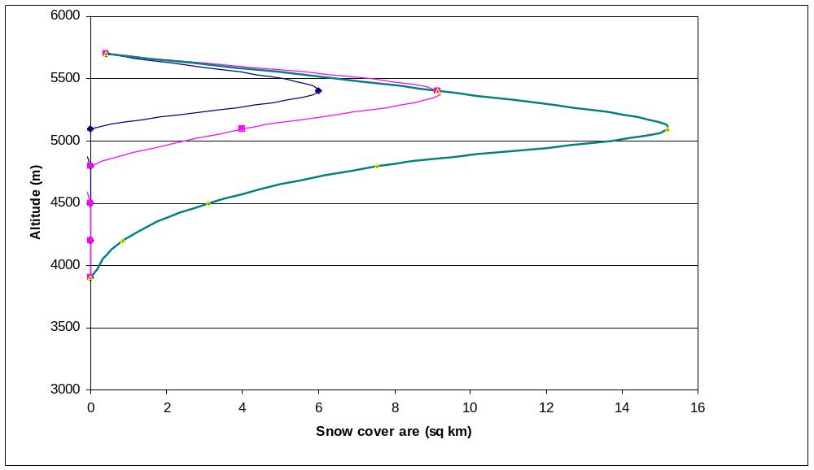
CHANGES IN GLACIER AAR DUE TO RISE IN TEMP BY 1 DEG C
From: Kulkarni et al., 2010
AAR WILL CHANGE FROM 0.37 TO 0.17 DUE TO 1 DEG RISE IN TEMP

Slide 22
Estimated seasonal runoff (cumecs) in Wangar Gad basin due to rise in temperature by 1oC
(Rathore and Kulkarni, 2009)
-28 %
-8 %
-20 %
-18 %
Autumn
Winter
Summer
Monsoon

Slide 23


SALIENT OBSERVATIONS
Retreat of 1868 glaciers in 11 basins suggest 16 % loss in area from 1962. Monitoring of 34 glaciers in Baspa and Tista basins suggest acceleration of rate of retreat.
Mean of glacial extent reduced from 1.4 to 0.32 sq km. Number of glaciers increased due to fragmentation but extent is reduced.
Field and remote sensing based observations and models suggest loss of 19 m of glacier ice from 1976. Annual loss in glacier ice is increased from -0.41 to -0.91 m from 1970s to present.
Snow line at the end of summer changed from 4900 m to 5300 m from 1970. Many glaciers are without accumulation area and may experience terminal retreat due to lack of formation of new ice.
Large scale melting and retreat of seasonal snow was observed in basins like Ravi throughout the winter. In high altitude basins like Baspa and Bhaga, large scale retreat was observed in beginning of winter.
Average stream runoff of Baspa river in December was increased by 75 per cent from 1970.

Slide 24
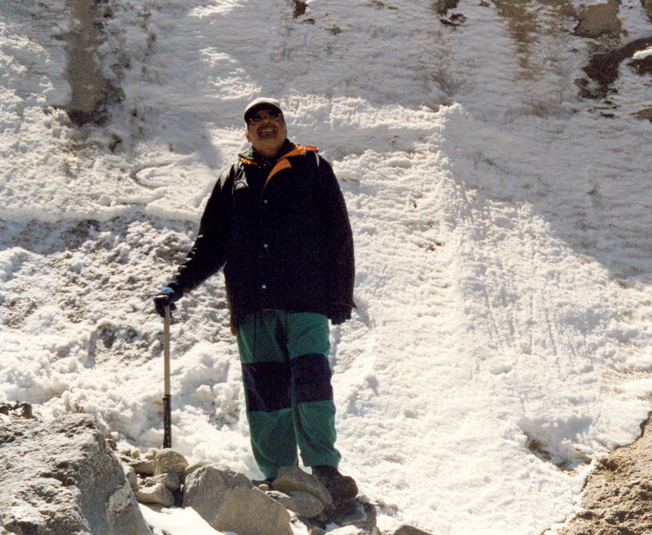
TERMINUS OF PARBATI GLACIER
THANKS

