Slide 1
Sea Ice Melting in ARCTIC
Yongjia Song
Georgia Institute of Technology

Slide 2
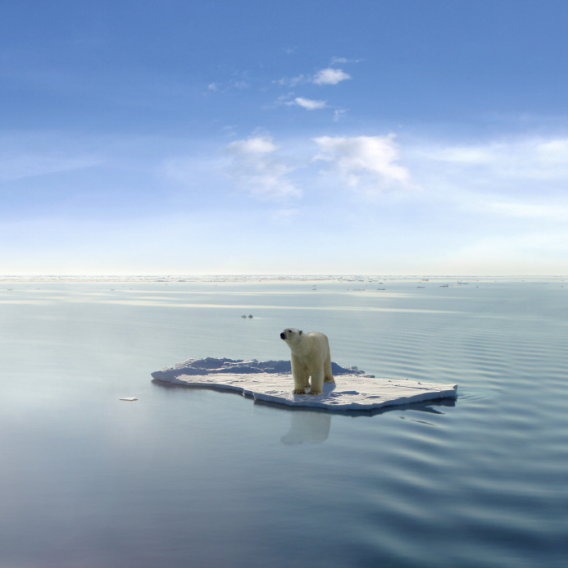
Notes:
First of all, I give a story here, In 2005, it is first time for people to see several cases of polar bear were drowned in Arctic ocean, we know the polar bear is a very good swimmer, they can swim more than 100km continually. This event prove the more melting of sea ice in Arctic in summer.

Slide 3
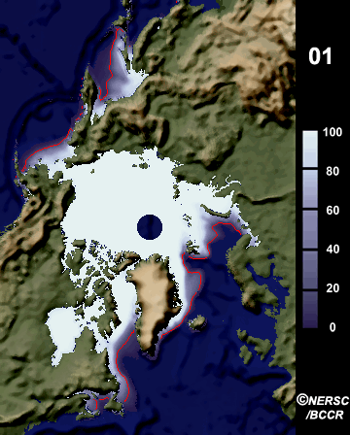

Slide 4
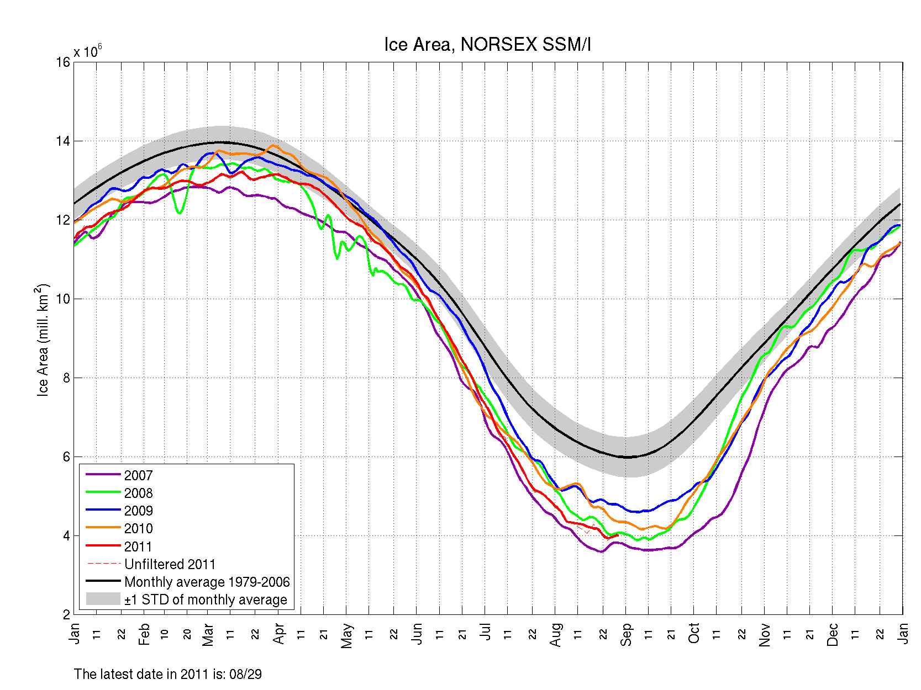
Notes:
Arctic sea ice reach maximum in march and reach minimum in September in each year. The black thick line is the average of sea ice from 1979 to 2006. shaded area is standard deviation to average sea ice of this period. Pink, blue and red lines are sea ice in 2007, 2008 and 2009 respectively. We notice that All these three years 2007,2008, 2009 are much low than average of last thirty years. Especially 2007, which has the lowest arctic sea ice so far, the historical low record happened in mid of Sep in 2007.

Slide 5
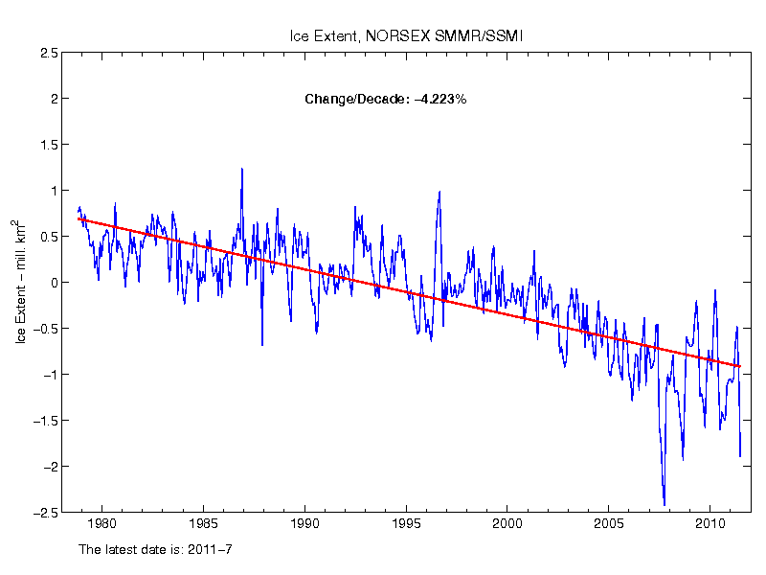
Anomaly of long-term monthly Sea Ice Extent in the Arctic
Notes:
From the anomaly of sea ice in arctic during last 30 year, a obvious decline trend can be found. Sea ice decrease about 4 percent every 10 years, if we note the the curve after 2000, there is bigger decline trend than the whole period. What is relative to sea ice melt directly? Yes, Global warming, let’s look at the temperature variation during last 130 years.

Slide 6
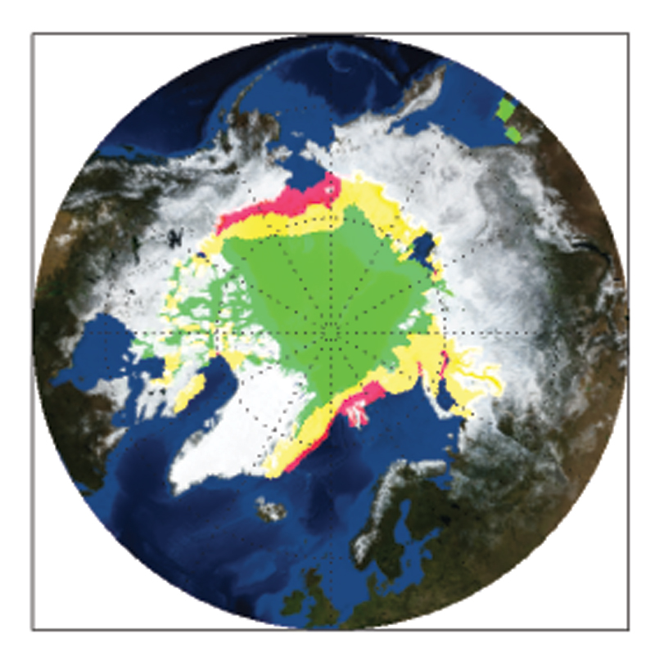
Arctic Sea Ice in Summer
1980
1999
2004

Slide 7
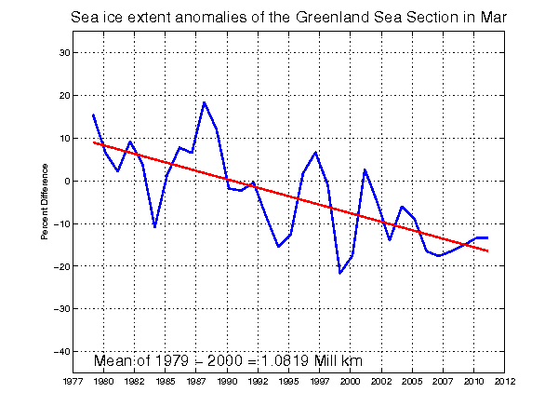
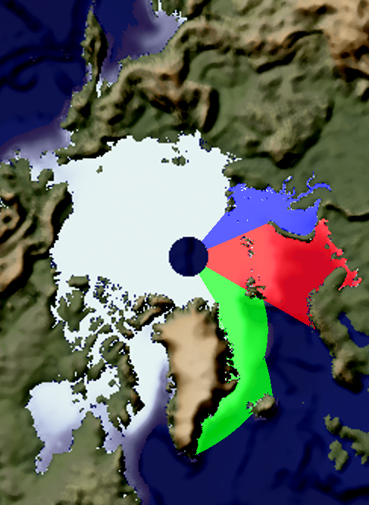
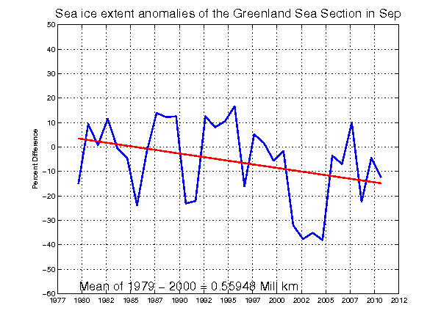
MARCH
SEPTEMBER

Slide 8
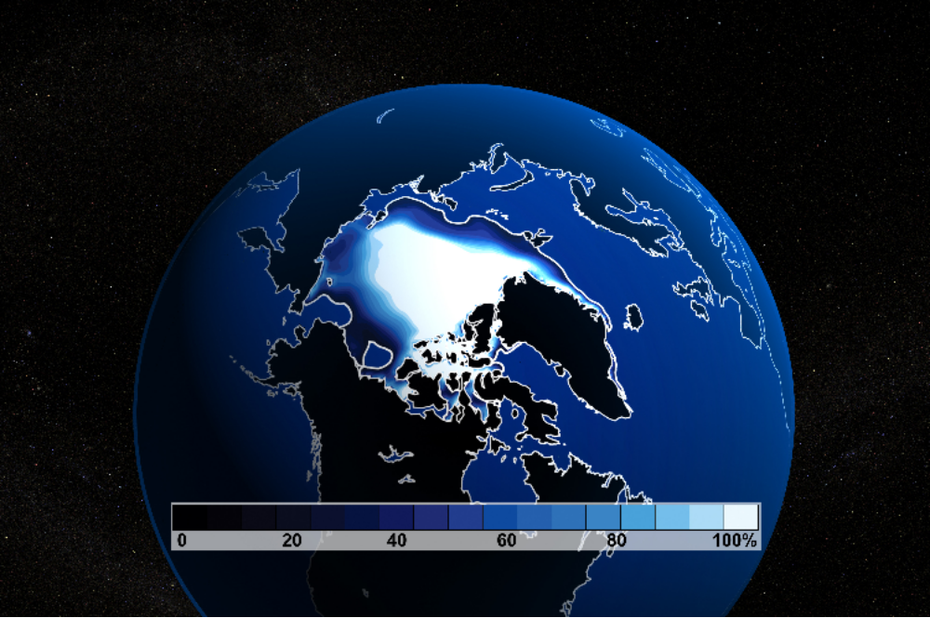
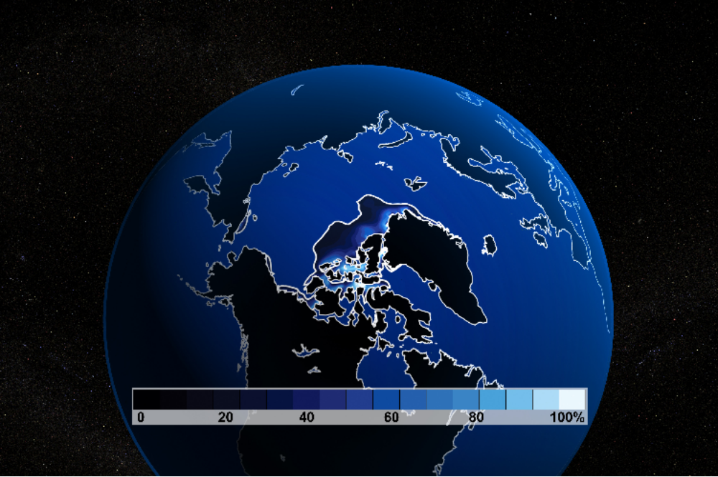
Arctic Sea Ice minimum
In Year 2000
Arctic Sea Ice minimum
In 2100
Notes:
Based on CCSM model simulation, the result show sea ice in Arctic will melt totally.

Slide 9
Reason?
Notes:
The reason for arctic sea ice melting is global warming definetely.

Slide 10
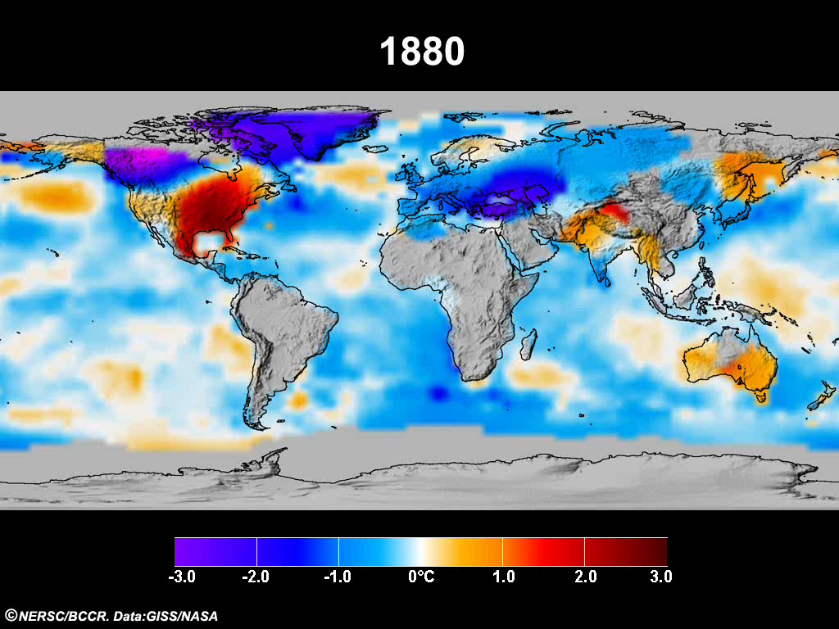

Slide 11
What will happen when Arctic sea ice melt totally?
Sea Level Rising
Sea level will increase 7 meters when snow cover over Greenland melt totally.
Sea level will increase 70 meters when Sea ice in Arctic and Antarctic melt, plus snow cover melt over Greenland.
Notes:
Sea level rasing is the one of the consequence of sea ice melt totally.

Slide 12
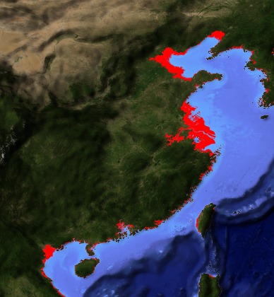







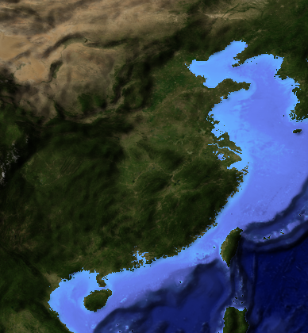
Sea level rising on China
0 meter
1 meter
2 meter
3 meter
4 meter
5 meter
6 meter
7 meter
8 meter
>100 MILLIONS PEOPLE WILL LEAVE HOME!

Slide 13
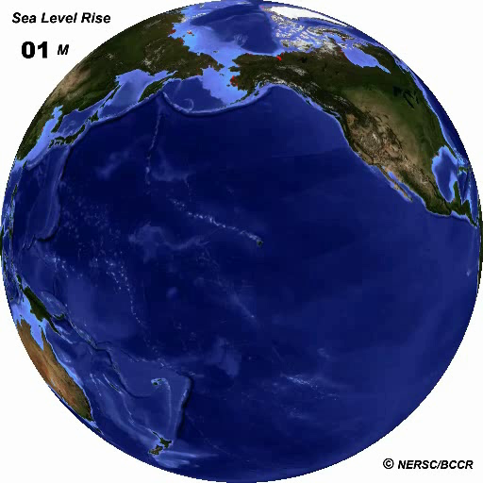
Global Sea Level Rising

Slide 14
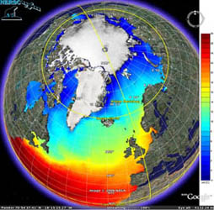
Arctic-roos.org
Notes:
These figures show the comparison of sea ice extent in 2005 and 2007, we could find much less sea ice in arctic in 2007 compared with 2005, the pink line is climatology sea ice extent during last thirty years. Let’s see the most recent sea ice area satellite image which is just two days ago. It has about 6 mill sq.km so far. The information come from website arctic-roos.org which is I created in 2008. So how is the current sea ice in historical record? Is it still going down?

Slide 15
Thank you!

Slide 16
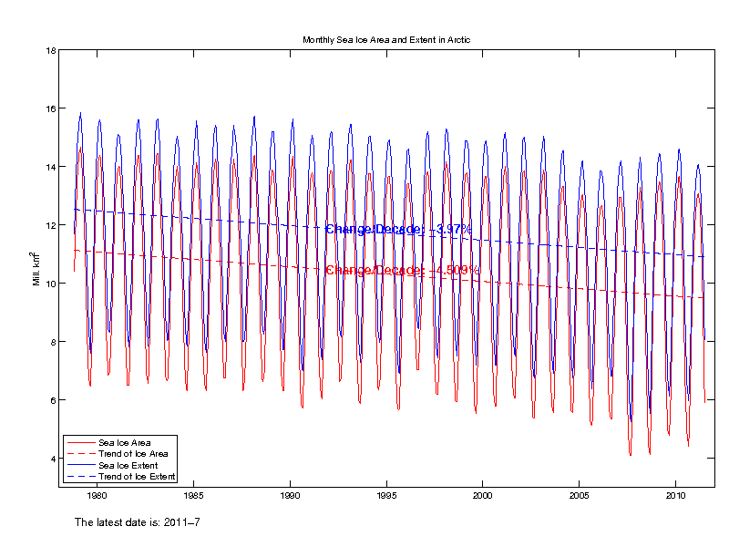
Variability of monthly Sea Ice Area in the Arctic

