Slide 1
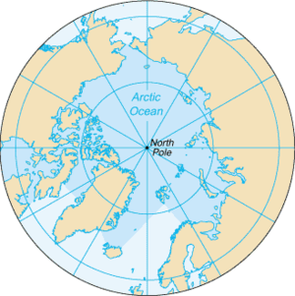
Securitization of Climate
Change in the Arctic
The Case of Iceland
Auður H Ingólfsdóttir
- Assistant Professor, Bifröst Univeristy (Iceland)
- Joint Degree Ph.D. Student at University of Iceland and University of Lapland (Finland)

Slide 2
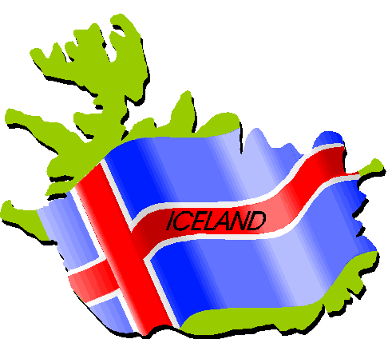
Key Questions
Is climate change perceived as a security threat in Iceland?
Is so, who is threatened and what are the threats?
Has the securitization of climate change influenced Iceland´s foreign policy, and its domestic climate policy?

Slide 3
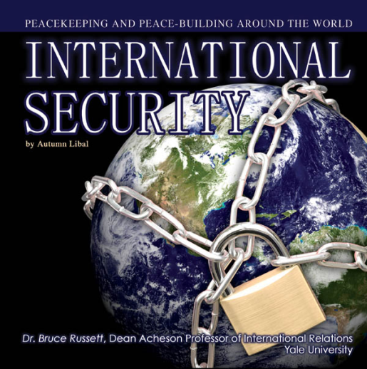
Climate change and international security
Is climate change a security issue?
The securitization process (Copenhagen School)
2007: Turning point for securitization of climate change at the international level
2009 – Copenhagen summit (failure?)
Impact of financial crisis?

Slide 4
Geopolitics in the Arctic
After the Cold War: Thaw in military tension and a spirit of cooperation
Will climate change create new challenges with respect to security?
ACIA: highlights challenges to both natural systems and human settlements
Focus in media: Upcoming resource race and the danger of conflict

Slide 5
What is really going on?
Russian official in a public meeting:
  The predominant feature of state of affairs in the Arctic is low tension, growing cooperation and mutual trust among the regional states, who will not allow to “rock the boat” or impose on themselves non-existent or artificially overblown problems.
    Nordic Council of Ministers (2010). Arctic – Changing Realities. Conference arranged by the Nordic Council of Ministers, 26 May 2010. Copenhagen, Denmark. ANP 2010: 758
Russian ambassador to NATO in secret caple released by Wikileaks:
  the 21st Century will see a fight for resources and Russia should not be defeated in this fight
    Jones, m. & Watts, S. (2011). “Wikileaks cables show race to carve up Arctic” May 12th 2011. BBC News

Slide 6
Iceland and security concerns
Nordic country and cooperation with NATO and the US on security issues
Arctic identity building more recent
Climate change is identified as a threat and a security issue in Iceland´s foreign policy documents
What are those threats and which groups are threatened is not clear

Slide 7
Iceland and security concerns – cont.
Military tension due to a resource race not considered likely
Dependence on natural resources (fisheries, hydropower etc.) that could be greatly impacted by climate change, but thorough analysis are missing
Lack of research on socioeconomic impact of climate change
Securitization seems to come from “above” (global discussion), rather than from the “bottom” (local concerns)

Slide 8
Human security at local level
Are Icelanders concerned?
  40% are gravely concerned about climate change
  36% feel that climate change is already impacting their local environment
Climate change policy at national level more ambitious since 2007
  Before 2007, key focus on more narrow economic interests
  The financial crisis have in some ways paved the way for implementation of climate policies
Climate change policies at local level, if they exist, focus on mitigation but not on adaptation
Difficult to separate climate change impacts from other factors, both environmental, political and cultural

Slide 9
Concluding thoughts
The framing of climate change as a global issue has influenced policy discussion domestically, both at the national and local level
  Global responsibility to prevent catastropes in faraway places
Resource race receiving much attention even if not very likely
Lack of awareness of potential human security challenges at the local level, although those are very likely to happen

