Slide 1
The Northern Research Forum, a case study for High Northern cooperation.
Margrét Cela,
PHD Candidate, University of Lapland,
NRF 6th Open Assembly,
Hveragerði, 3.-6. September, 2011

Slide 2
Cold War
Militarization
Deterrence
Indirect confrontation

Slide 3
End of Cold War
Regan – Gorbachev meeting in Reykjavík -1986
Murmansk speech - 1987
Broadening out of the security concept
Increased (environmental) cooperation
Stability
New institutions and forums for cooperation
NRF

Slide 4
Globalization
The Arctic is no longer a private matter of the Arctic states
What happens in the Arctic has global impacts
Unified states (Arctic 5/8 + others) - intergovernmental organizations (IGOs) - international non-governmental organizations (INGOs) - private/state owned/ multinational businesses...

Slide 5
From stability to peace
Negative peace
Positive peace
Peace-building
Securtization and de-securitization

Slide 6
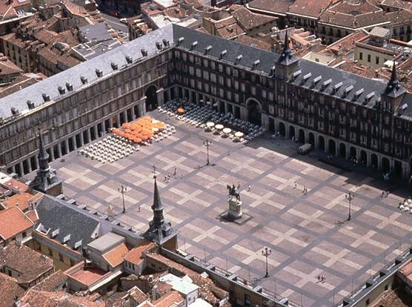
Northern Reseach Forum:
The town squere

Slide 7
NRF - Structure
Working procedures
Working groups – networks
Openness
The integration of early career scientists (Yong researchers)

Slide 8
NRF:
Contributions to the development
Confidence building
Trust
Cooperation
Transparency
De-securitization
Dialouge
Inclusions

Slide 9
NRF - challenges
Can the NRF keep up with the development?
Can the NRF keep up with other forums for cooperation (institutions, organizations...)?
Can the NRF keep on renewing itself?

Slide 10
Conclusions
After the Cold War – new security scenario
The Arctic is highly globalized
We must always aim for positive peace
The NRF can and does contribute

