Slide 1
North Atlantic Micro State Security Governance: Facing Structural, Natural and Political Challenges Historically, Today and in the Future
Rasmus Gjedssø Bertelsen, PhD
United Nations University—Institute of Advanced Studies
Tokyo Institute of Technology
Aalborg University
Rasmus@cantab.net

Slide 2
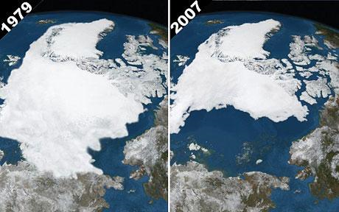
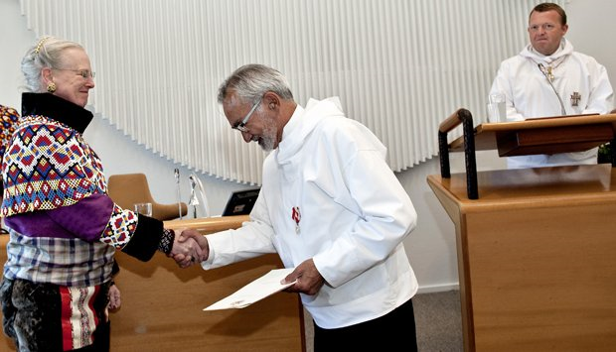
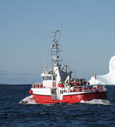
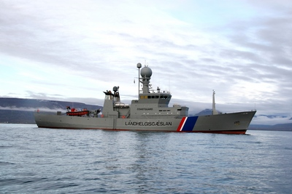
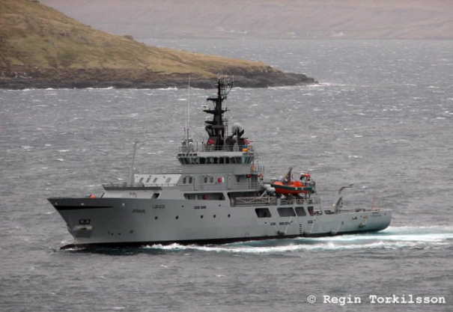
Nexus of Environmental and Political Processes in the North Atlantic
Climate Change
Independence Politics
Security Policy

Slide 3
Interacting environmental, structural and political conditions for security policy
Climate change: warming (increased energy exploration and shipping)
Arctic and Subarctic (expensive) environmental conditions, energy, marine resources
Permanent structural conditions: highly developed micro-states (limited absolute capabilities) with vast strategic spaces
Long term political change: Faroese and Greenlandic increasing self-government

Slide 4
Policy challenges for micro states with vast spaces
Public finance dilemma: few taxpayers for large investments and expenses for patrol vessels, aircrafts, helicopters, etc.
Public administration dilemma: small organizations with limited specialization
Foreign/security policy challenge: exercise effective sovereignty, etc., over vast spaces with very limited absolute resources
Successful mix of domestic capabilities and alliance partnerships
Creating vocabularies and capacity

Slide 5
Iceland—history
Setting the Direction for North Atlantic Microstate Security Policy
Security through distance
Viking settlers
Norwegian king 1262, Danish-Norwegian union 1380
Sporadic Danish/Norwegian naval activity
Althingi 1845, legislative, budgetary power 1874
Home rule 1904, Islands Falk 1906, Coast Guard Fund 1913
Kingdom of Iceland 1918, Þór 1924, Óðinn 1926
Republic of Iceland (1940) 1944

Slide 6
Iceland—current
Geopolitical integration through technology
NATO, US-Iceland defense agreement
Mix of domestic (Coast Guard, etc.) and foreign (US) capabilities
Cod Wars
Domestic expertise and vocabulary
Policy, capabilities and legislative review after Keflavik shock 2006
Financial crisis

Slide 7
Iceland—future
Climate change, energy, shipping
Increased energy shipping between Barents Sea and North America
Trans-Arctic shipping, transshipment in Aleutians and Iceland?
EU membership?

Slide 8
Faroe Islands—history
Viking settlers, absorbed by Norway, Danish-Norwegian union, Kiel peace
Løgting 1852
Icelandic inspiration, family ties
Streneous WWI connection with Denmark
British WWII occupation

Slide 9
Faroe Islands—current
Home rule 1948
LORAN station, GIUK gap, NATO Sornfelli radar
Copenhagen defense and security policy and partnership
Broad security concept
Faroe Islands Fisheries Inspection

Slide 10
Faroe Islands—future
2005 home rule, take over policy areas such as police, air traffic, etc.
Enter into international agreements
Membership of international organizations
Energy exploration, trans-Arctic shipping

Slide 11
Greenland—history
Inuit immigration
Norse settlers, king of Norway, disappearance
Danish-Norwegian recolonization in 1721, Kiel peace
US bases, US-Danish 1941 and 1951 agrements
County status 1953
Home rule 1979

Slide 12
Greenland—current
Key role in North American/North Atlantic security
Thule and National Missile Defense
Igaliku agreement, 2004
International aggreements 2005

Slide 13
Greenland—future
Self rule 2009, ’people’, natural resources, issues, independence
Funding (growing) independence
Climate change, energy, shipping

Slide 14
Discussion
Research and policy debate on organization of broad security in North Atlantic in face of:
Climatic challenges (warming)
Environmental challenges
Structural challenges (micro-states)
Political challenges (US withdrawal, FO & GL growing self-government)
Balance between domestic capabilities and alliance partnerships
Smart security for small island states
Thank you
Rasmus@cantab.net

