Slide 1
Sovereignty as a Social Issue:
The case of Inuit Nunangat
Mark Vardy, PhD candidate
Department of Sociology
Queen’s University
Ontario, Canada
The 6th Open Assembly of
the Northern Research Forum
Hveragerdi, Iceland
September 5, 2011

Slide 2
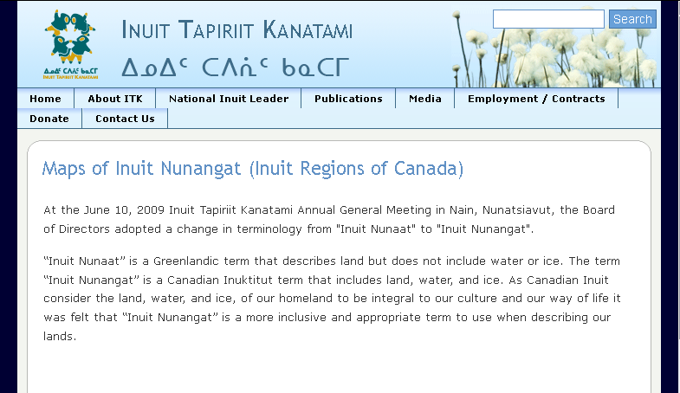

Slide 3
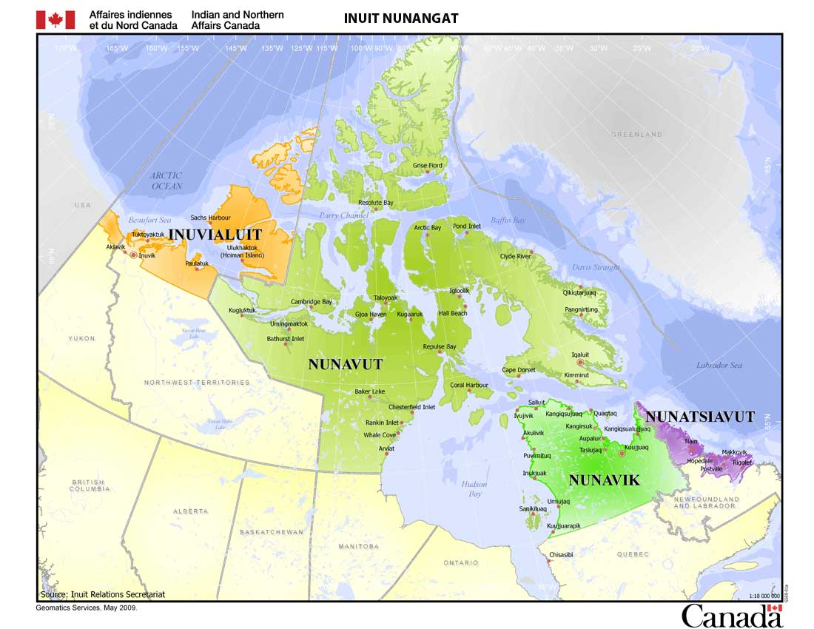
Source: Aboriginal Affairs and Northern Development Canada
http://www.ainc-inac.gc.ca/ap/in/irs/mpb-eng.asp

Slide 4
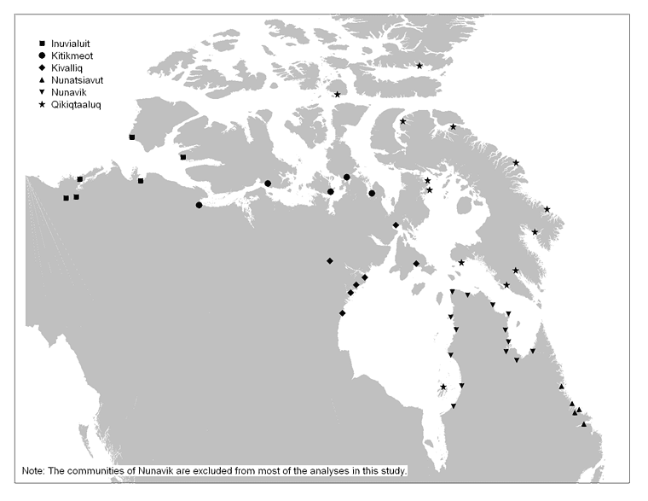
Communities in Inuit Nunangat, by region, Canada, 2006
Source: Statistics Canada
http://www.statcan.gc.ca/pub/85-561-m/2010020/m021-eng.htm
Notes:
Here we see more clearly that Inuit Communities are coastal.

Slide 5
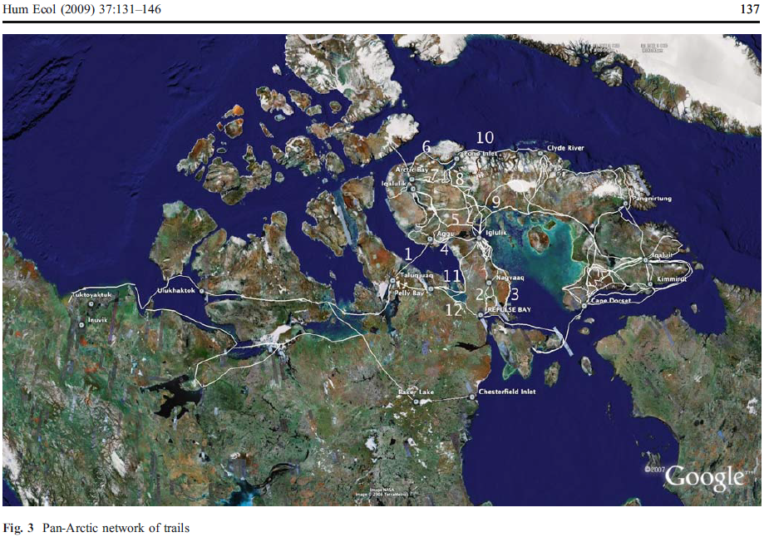
Claudio Aporta. (2009). “The Trail as Home: Inuit and Their Pan-Arctic Network of Routes.” Human Ecology. 37:131–146
Notes:
Not only are settlements coastal, here we see compelling evidence that Inuit in Inuit Nunangat rely upon sea ice for travel and hunting, in fact for all aspects of life – as an example of this, iglus are built on sea ice to capture ocean’s warmth (just as the Icelanders heat their homes with geothermal energy, so too the Inuit),
Also Mayor Edward Itta gave a compelling account of the integral role of fast ice to whaling and cultural cohesiveness. More so than any map.

Slide 6
Questions
What are the implications of the inclusion of sea ice as territory in Inuit Nunangat for how sovereignty is understood and practiced?
Assuming an understanding of territory that includes sea ice, what, then, are the implications of sea ice reduction (for how sovereignty is understood and practiced)?
Notes:
Territory is often thought of as the necessary precondition of sovereignty – so much so that it is almost self-evident. But the point is, political theorists from Thomas Hobbes on down have, one way or another, presume territory exists prior to sovereignty. And this presumption is as entrenched in our modern political systems and ways of thinking as sea ice is entrenched in Inuit ways of life.
But what is meant by territory?
Stuart Elden, a British political geographer, analyses territory.
Land → property (something to be owned, bought and sold);
terrain → zone of military strategy;
territory combines these two plus legal and technical means of defining it.
So territory, as a way of measuring and controlling land, is then entirely political as it is defining what and where politics can be.
So – to return to the first question -- including sea as territory is a radical proposition, because it asks us to rethink the very categories through which we are approaching this problem. It is a spatial question, how we imagine space. We heard from Dr. __ about how the term sea ice was dropped from certain negotiations.
(In regards to the second point) this introduces a temporal dimension, it asks us to think about the future implications of our current practices. (reference end of position paper)
The issue is that territory, as a self-evident distinction from the ocean, is as essential to modern conceptions of sovereignty as sea ice is to the Inuit way of life.

Slide 7
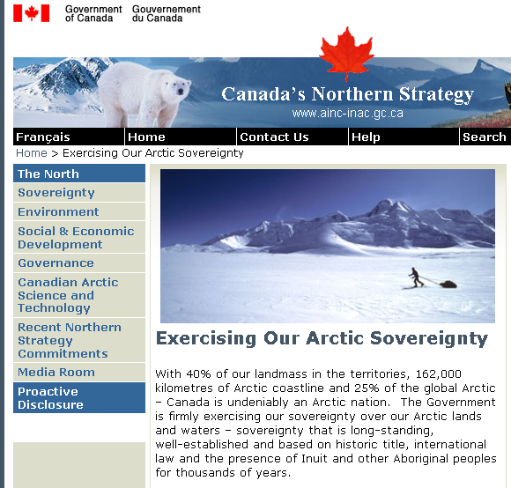

Slide 8
Complexities of Canada’s Claims to Arctic Sovereignty
Sovereignty was ceded from Inuit to Canada in Nunavut with certain conditions
Article 23.2.1 of Nunavut Land Claim Settlement Agreement
2006: Nunavut Tunngavik Inc. launched lawsuit (ongoing)
2010: Auditor General of Canada’s report
UNCLOS vs UNDRIP?
Berger (2006); Byers (2009); (Loukacheva, 2009); Nicol (2010); Powell (2010)
Notes:
Not fulfilling treaty obligations weakens Canada’s argument that it is effectively exercising sovereignty in the Arctic.
From a legal standpoint, Nunavut can advance basis for self-determination by representing own interests in international contexts.

Slide 9
A Circumpolar Inuit Declaration on Sovereignty in the Arctic (2009)
“The actions of Arctic peoples and states, the interactions between them, and the conduct of international relations must give primary respect to the need for global environmental security, the need for peaceful resolution of disputes, and the inextricable linkages between issues of sovereignty and sovereign rights in the Arctic and issues of self-determination” (Section 3.2).
Notes:
Here I want to point out one thing: this document does not privilege the sovereignty of an individual nation state. Nor does it privilege the sovereignty of the system of nation states. A recent of example of this is the 2008 Issaluit Declaration. Rather, it privileges environmental security, peace… self-determination.

Slide 10
Questions, revisited
Modern International Relations:
System of sovereign states
Sovereign nation-states
Individual political subjectivity
Local knowledge and science ask us to consider future conditions to which we will have to respond.
Notes:
As Lassie Heninemen points out, the state centric picture excludes Indigenous people and their claims to land and water.
It is this third point I think is important here – how we as individuals in our everyday lives, and under what conditions, are we effective political actors. It is a moral and ethical question, but it is also historical – all this can change, and does change over time.
(point four) So the question is, is this configuration, which does not include sea ice as territory, adequate to dealing with those possible futures?

Slide 11
Conclusions
The historical specificity of sea ice reduction in Inuit Nunangat requires an understanding of sovereignty that emphasizes a “democratic ethos,” he need for people dwelling in a particular place to shape and legitimate the articulation and practice of sovereignty.
Connolly (2007)
Notes:
Sovereignty is not absolute or unchanging – and in an ice-reduced world, we need to open up concepts of sovereignty to democratic debate and discussion.
This could be all the more important given possibility for sudden changes.

Slide 12
Sources
Aporta, C. (2009). The Trail as Home: Inuit and Their Pan-Arctic Network of Routes. Human Ecology, 37(2), 131-146.
Berger, T. R. (2006) “The Nunavut Project: Nunavut Land Claims Agreement Implementation Contract Negotiations for the Second Planning Period 2003-2013.”
Byers, M. (2010). Who Owns the Arctic? Understanding Sovereignty Disputes in the North. Vancouver, BC: Douglas & McIntyre.
Connolly, W. E. (2007). “The Complexities of Sovereignty.” In Giorgio Agamben: Sovereignty & Life. Stanford University Press.
Dodds, K. (2010). Flag planting and finger pointing: The Law of the Sea, the Arctic and the political geographies of the outer continental shelf. Political Geography, 29(2), 63-73.
Elden, S. (2010). Land, terrain, territory. Progress in Human Geography, 34(6), 799-817.
Loukacheva, N. (2009). Nunavut and Canadian Arctic Sovereignty. Journal of Canadian Studies-Revue D Etudes Canadiennes, 43(2), 82-108.
Nicol, H. N. (2010). Reframing sovereignty: Indigenous peoples and Arctic states. Political Geography, 29(2), 78-80.
Powell, R. C. (2010). Lines of possession? The anxious constitution of a polar geopolitics. Political Geography, 29(2), 74-77.
Office of the Auditor General of Canada. (2010). Human Resource Capacity—Government of Nunavut. http://www.oag-bvg.gc.ca/internet/English/nun_201003_e_33568.html
Nunavut Bureau of Statistics (2011) http://www.eia.gov.nu.ca/stats/
Nunavut Tunngavik Inc . (2011) http://www.tunngavik.com/about/

