Slide 1
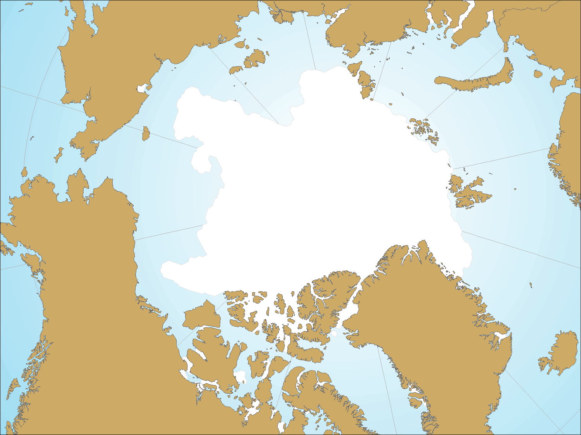
Evaluating Prehistoric Sea Ice Variability and Culture Change in Northwest Alaska
Adam Freeburg
University of Washington
Seattle, USA

Slide 3
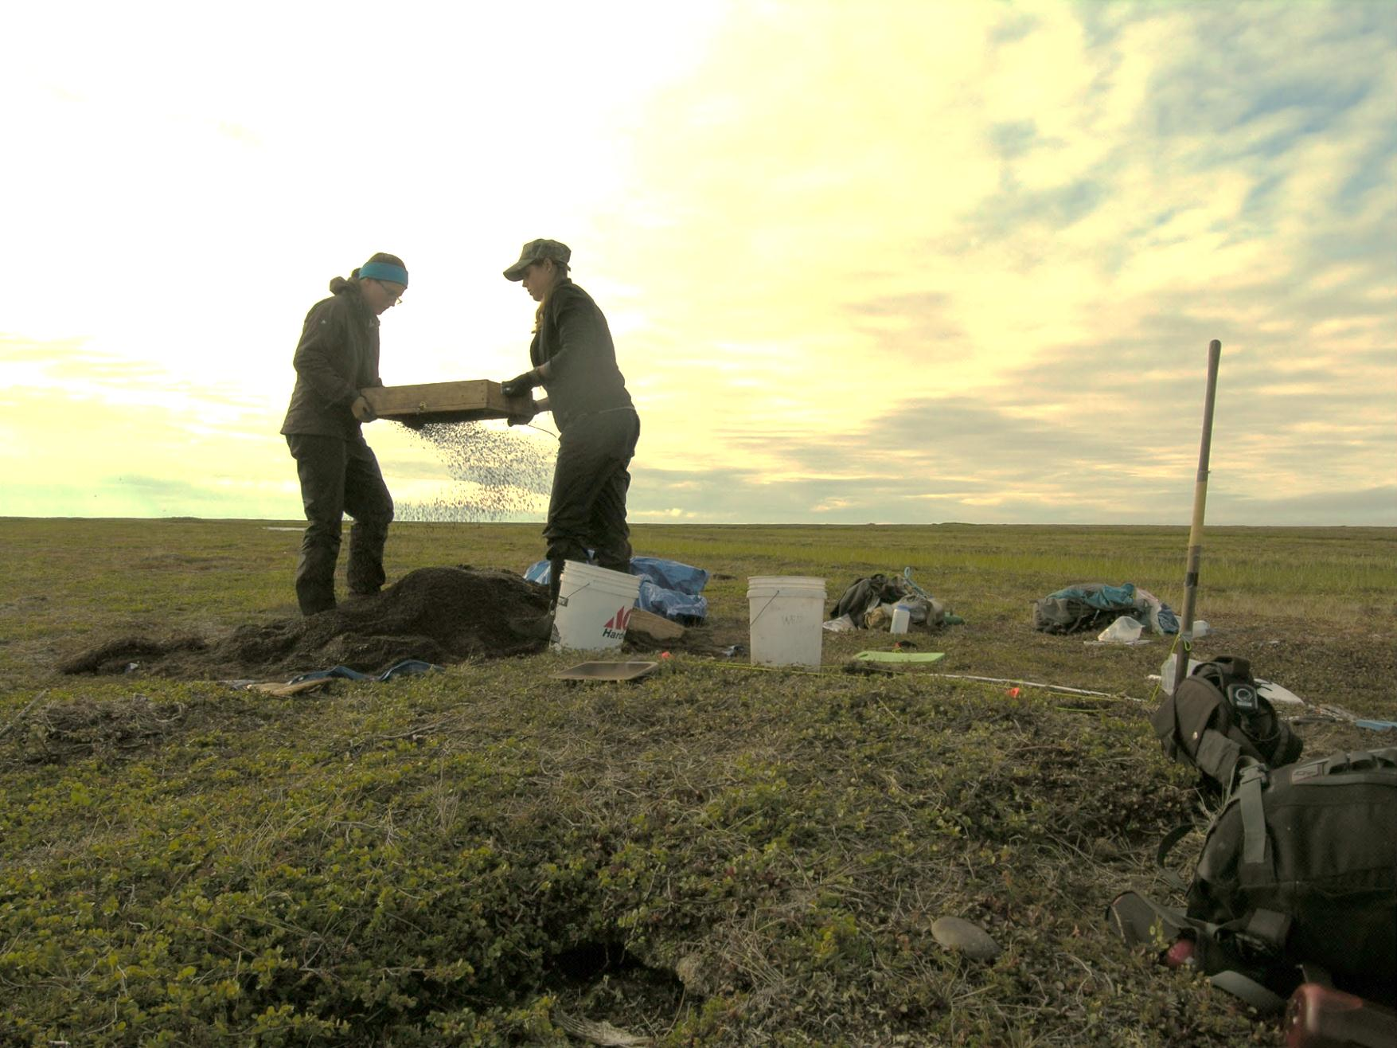
Archaeology provides...
Long term perspective
Interdisciplinarity
Human aspect

Slide 4
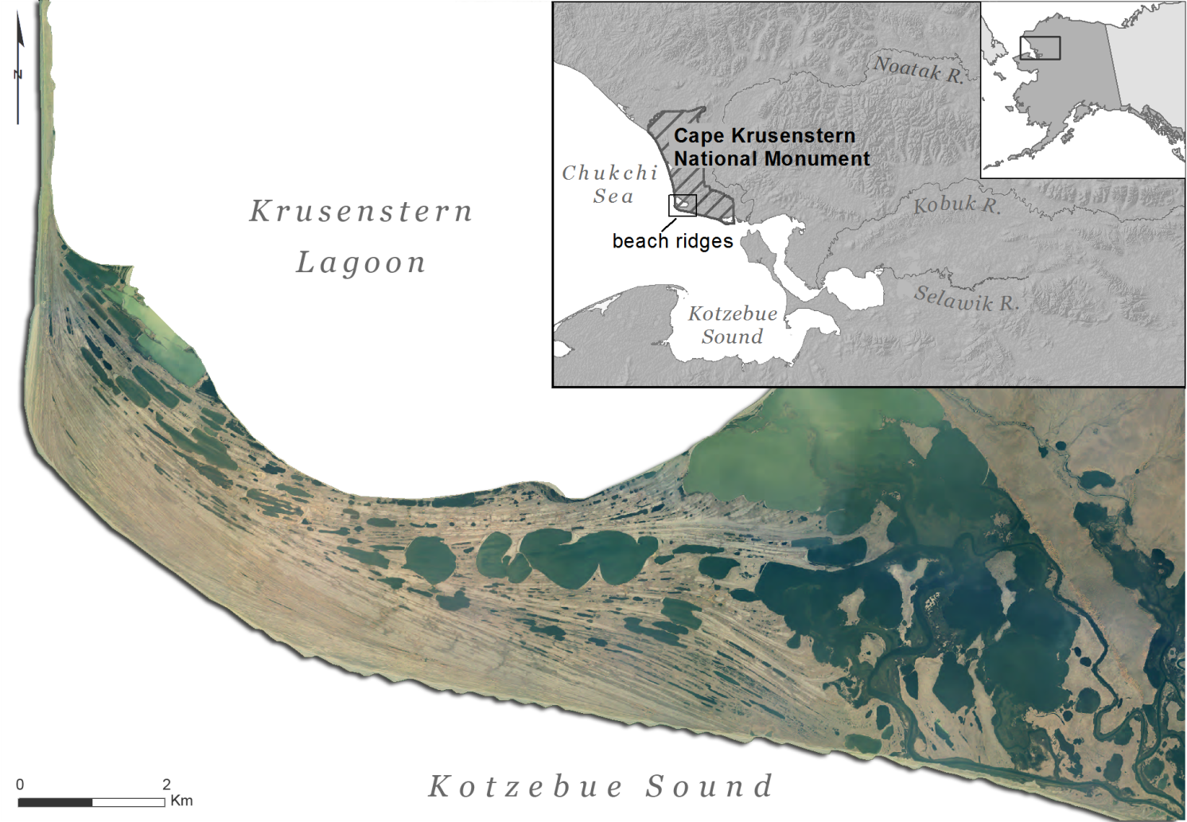
Orthophoto Manley et al. 2007

Slide 5
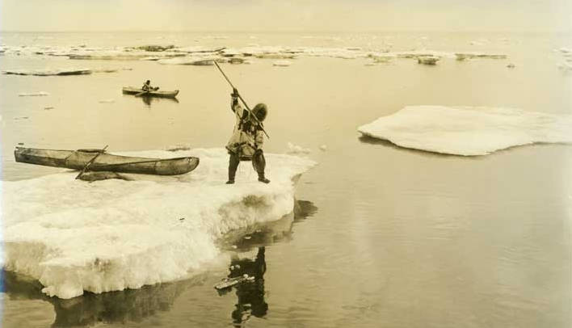
Ice as medium for...
Subsistence
Transportation
Living
http://vilda.alaska.edu

Slide 6
Ice as part of...
Subsistence Change
Culture change
Social Upheaval
Reconstructing the “icescape”
http://vilda.alaska.edu

Slide 7
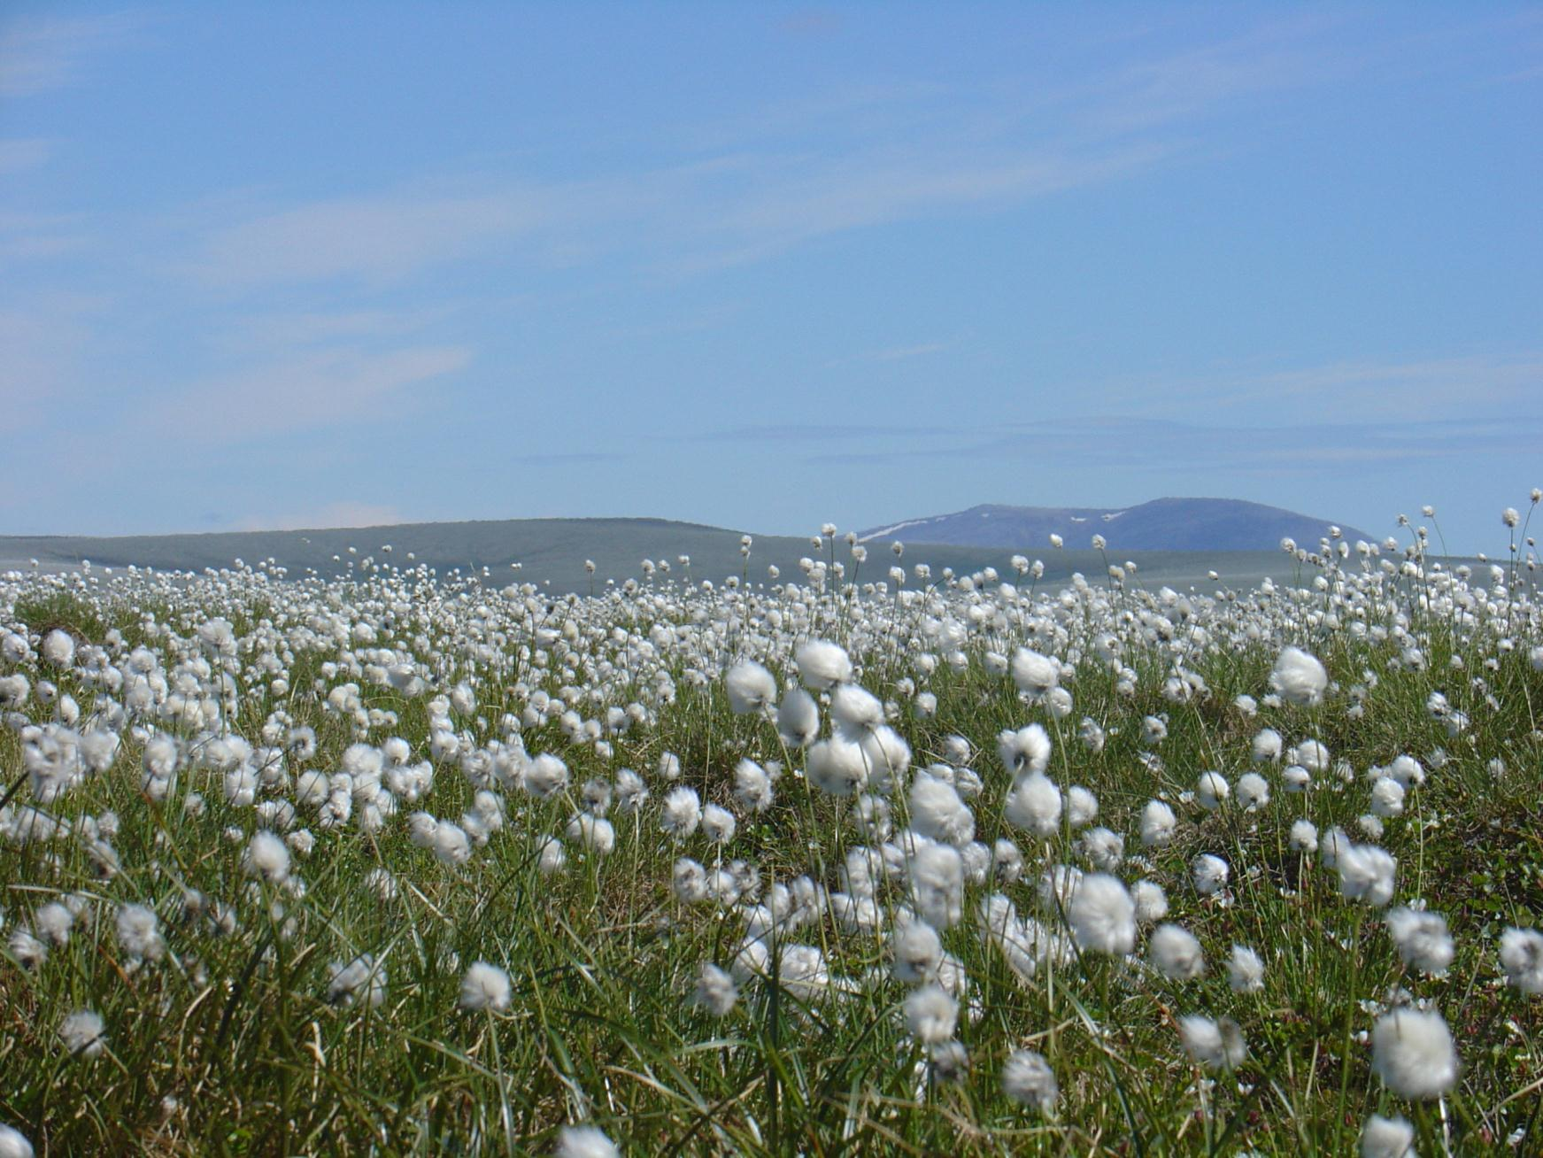
Paleo- proxies in NW Alaska
Tree rings
Pollen
Beach ridges
Archaeological fauna

Slide 8
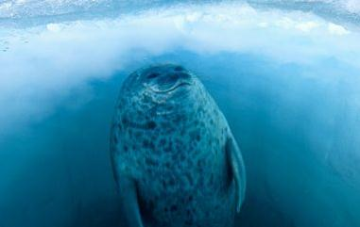
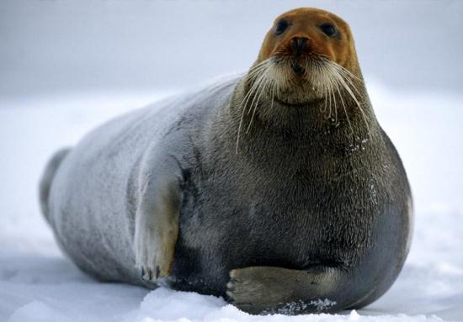
Fauna as Ice Proxy
Ringed Seal- Natchiq
(Phoca hispida)
Bearded Seal- Ugruk
(Erignathus barbatus)
Prefers fast ice
Sub-nivean lairs for birthing, nursing
Shorter ice duration can have impact on pup health, survival
Prefers pack ice
Birthing, nursing on floes
Available only when pack ice is accessible from land (spring or autumn)
Photos: National Geographic

Slide 9
Fauna as Ice Proxy
Ipiutak
A.D. 450-650
Thule
A.D. 1000-1200

Slide 10
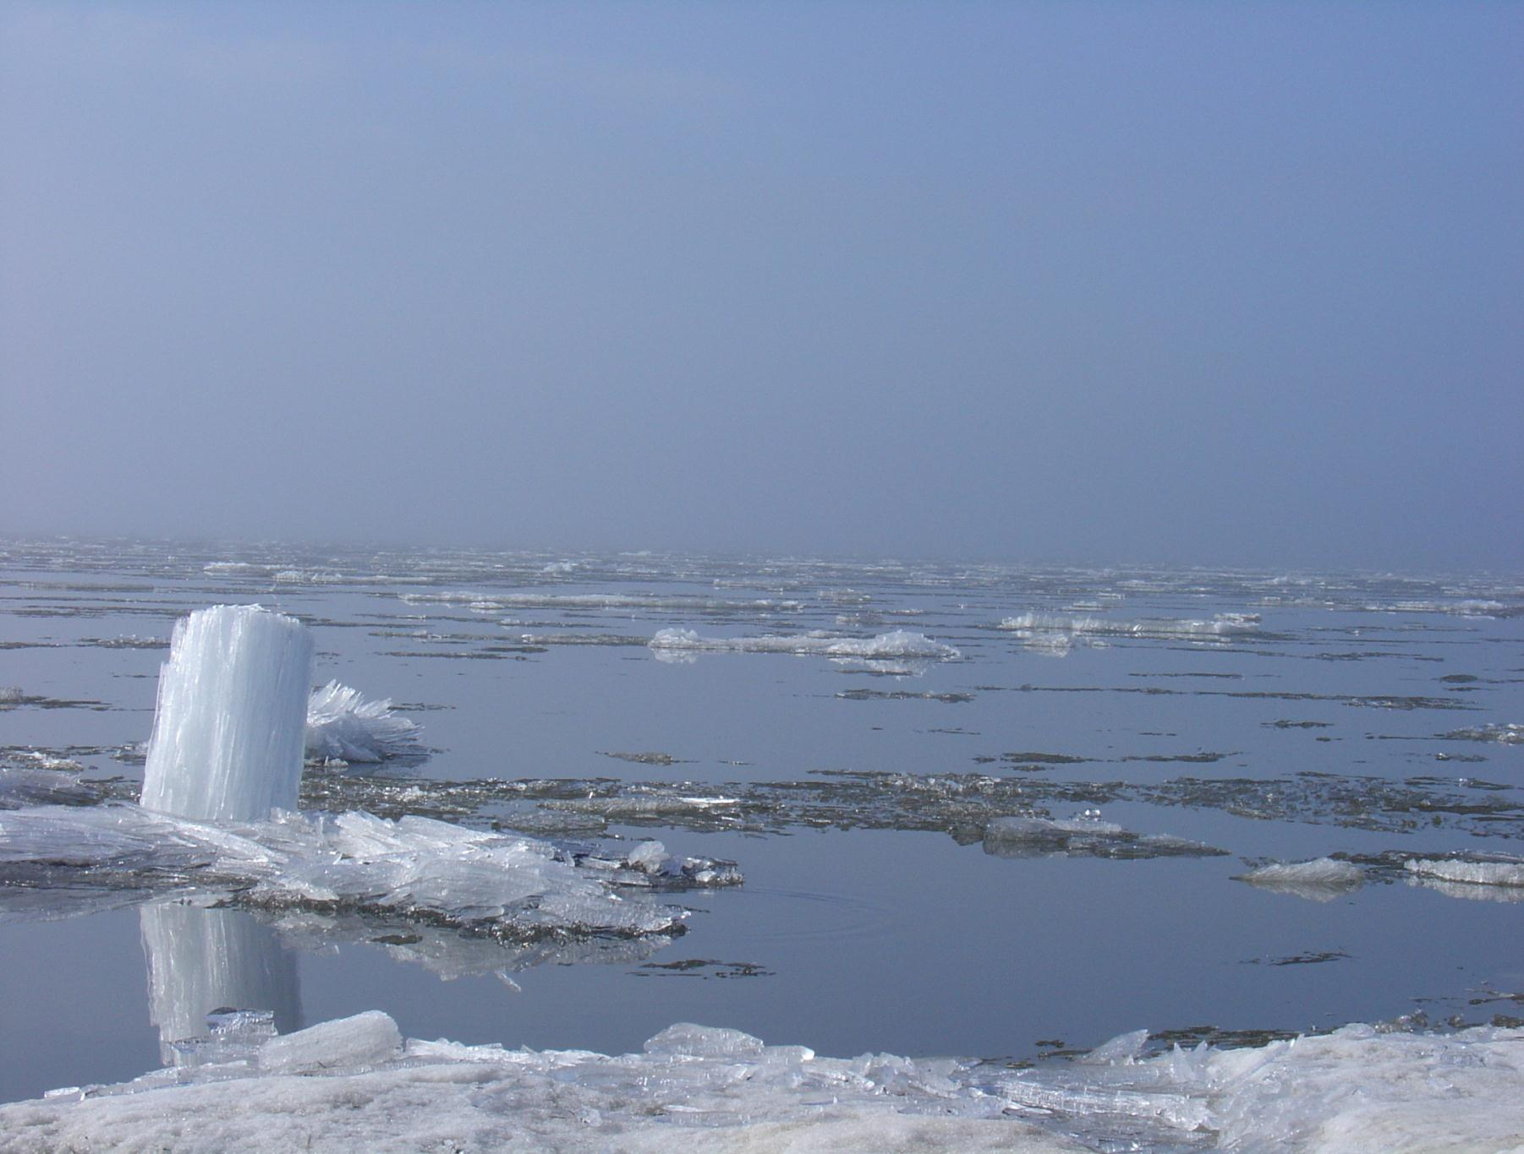
Fauna as Ice Proxy
Ringed:Bearded seal ratio change
Variability of ice extent/duration
Chronological resolution on human scale

Slide 11
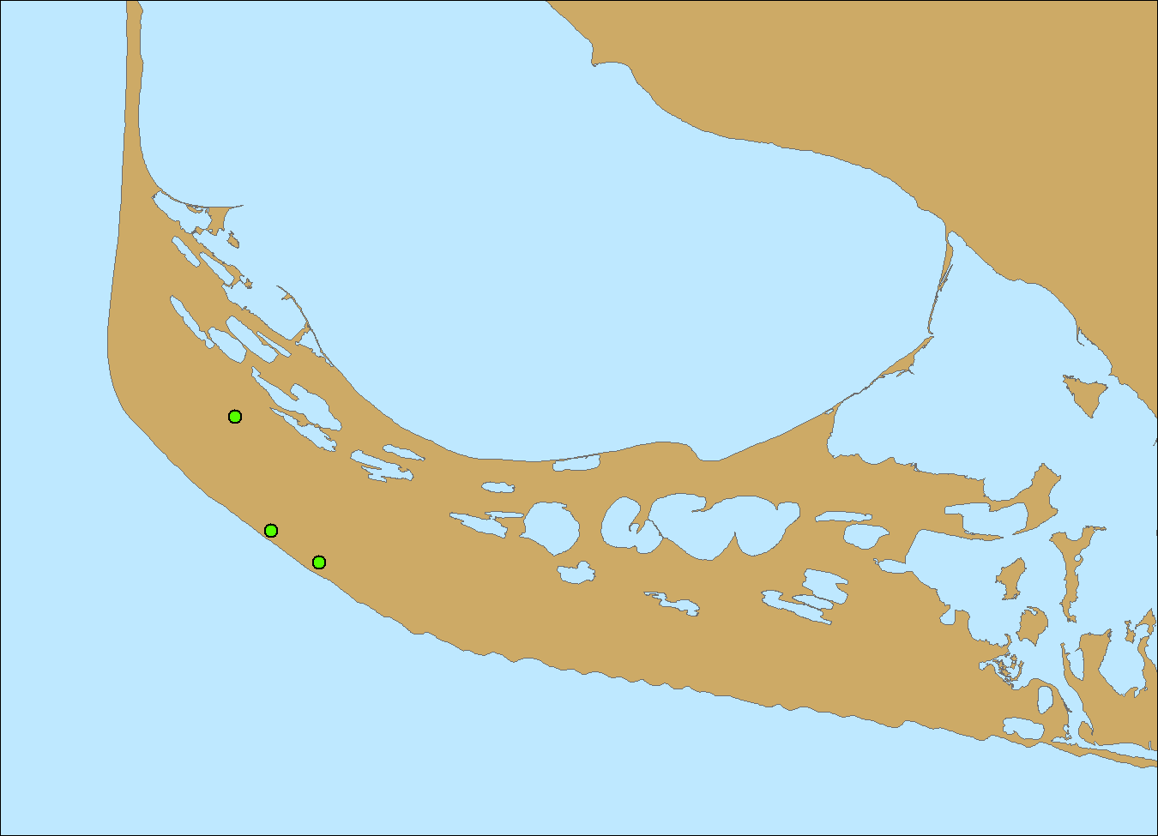
Ipiutak
(A.D. 450)
Kotzebue
(A.D. 1400)
Thule
(A.D. 1000)

Slide 12
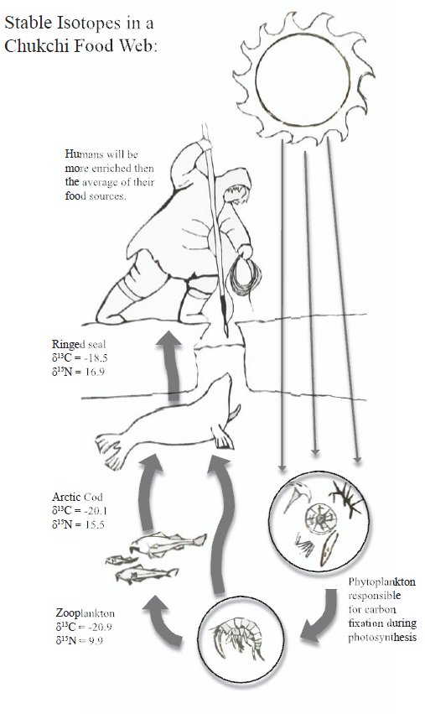
Ringed seal isotopes (Strathe 2007)
Increase in δ¹⁵N: widening diet
Decrease in δ¹³C: declining productivity
Productivity tied to timing, extent of sea ice

Slide 13
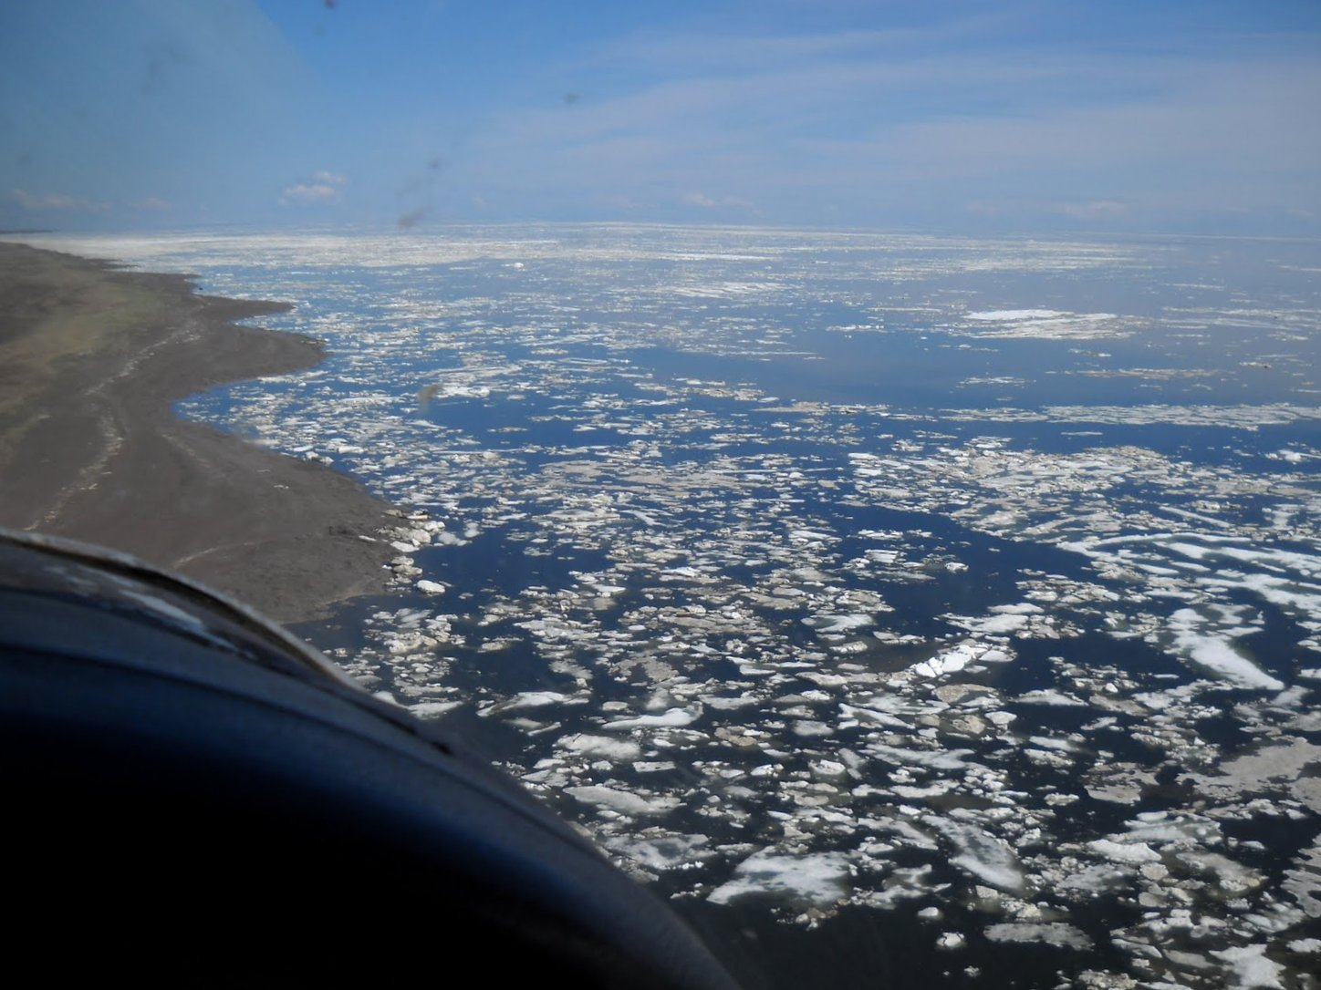
Summary
Archaeological fauna as paleo-ice proxy
Provide long term info on human scale and dimension
Test hypotheses of cultural interaction
Lessons of adaptation and resiliency- challenges and possibilities

Slide 14
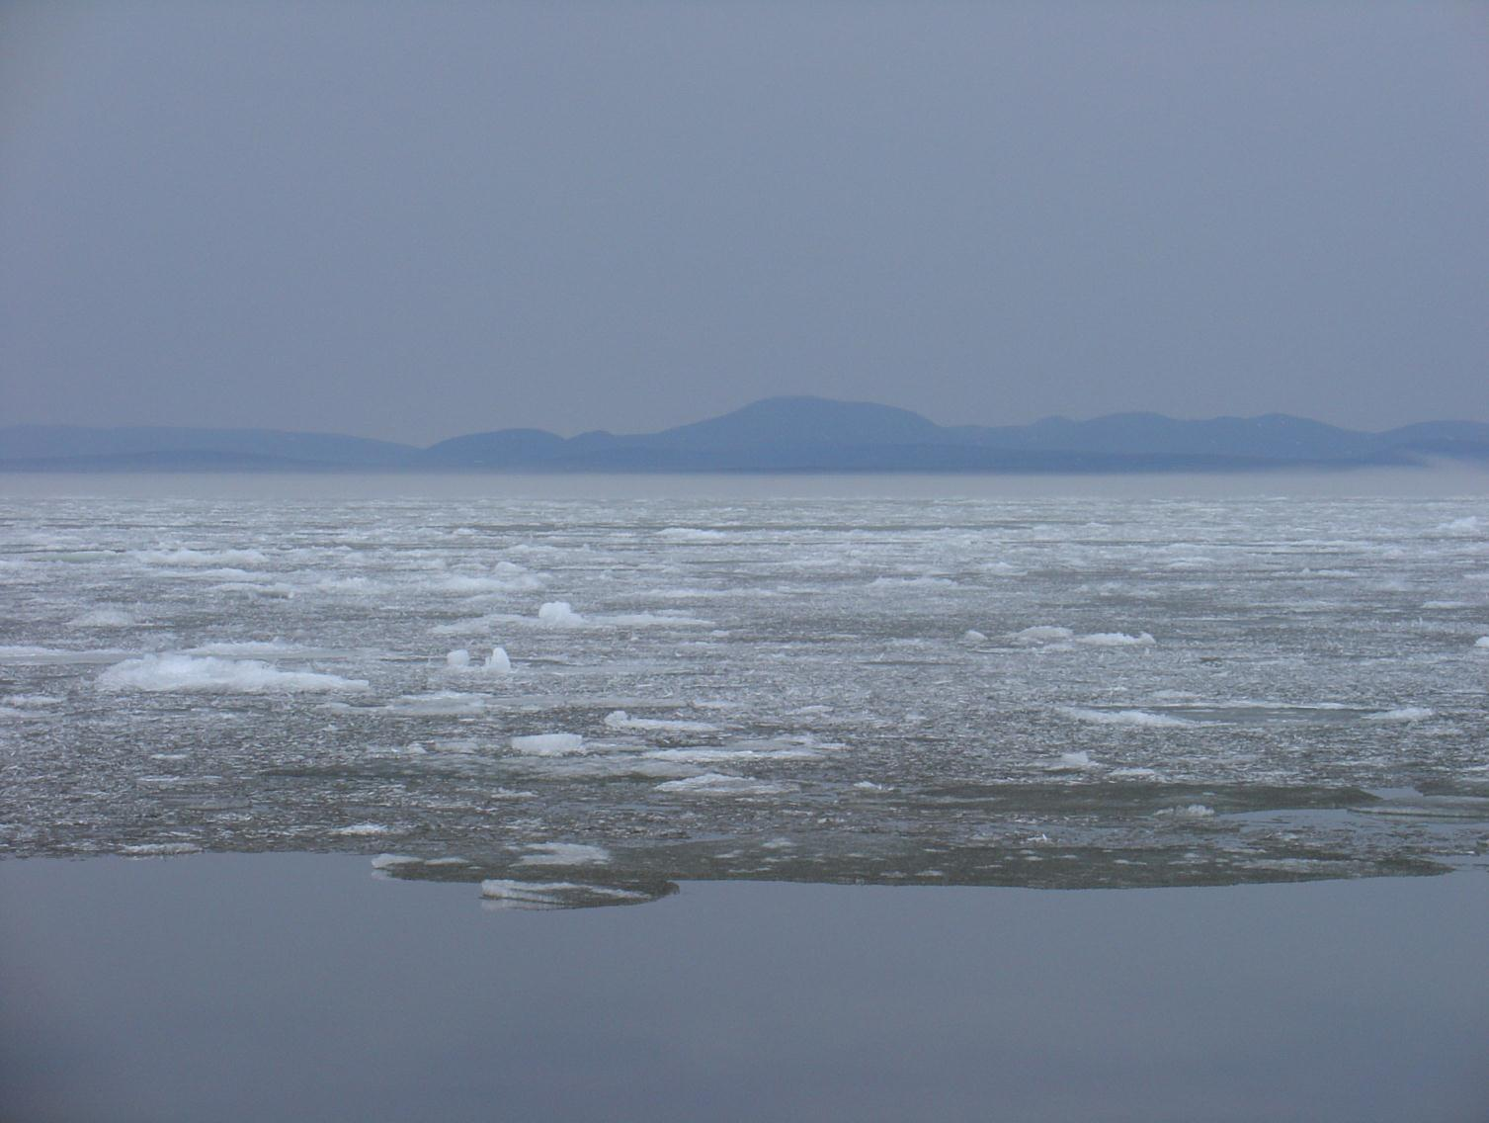
Acknowledgements
NRF: Young Researcher Fellowship
NPS: Alaska Regional Office and Western Arctic Parklands staff
UW: Ben Fitzhugh, Shelby Anderson, 2008-2010 crews, and CAKR Lab students
Herbert Foster, Krusenstern community, and Native Village of Kotzebue

Slide 15
