Slide 1
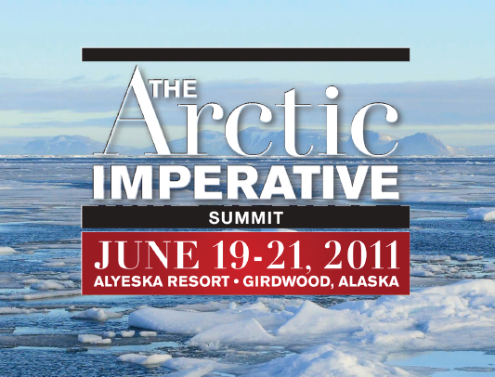
COOPERATION, INVESTMENT, DEVELOPMENT
NEXT YEAR: JULY 29-AUGUST 1, 2012
The Summit will bring together leading voices in this conversation, including residents from the small villages that comprise Alaska’s coastal communities; state, national and international leaders; the heads of shipping and industry; as well as international policymakers and the news media. The goal of the summit is to sharpen the focus on the policy and investment needs of Alaska’s Arctic through a series of high-level meetings, presentations, investor roundtables and original research.
ArcticImperative.com
Please contact: alice@alaskadispatch.com or megan@alaskadispatch.com
and +19079032147

Slide 2
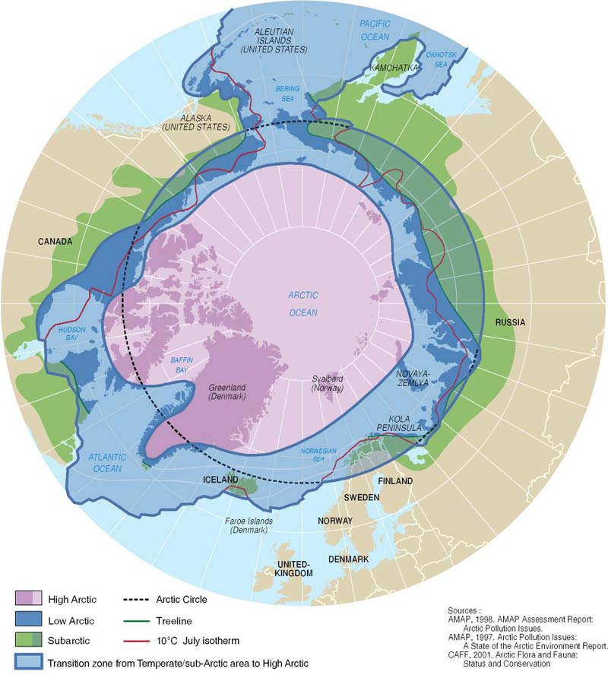

Slide 3
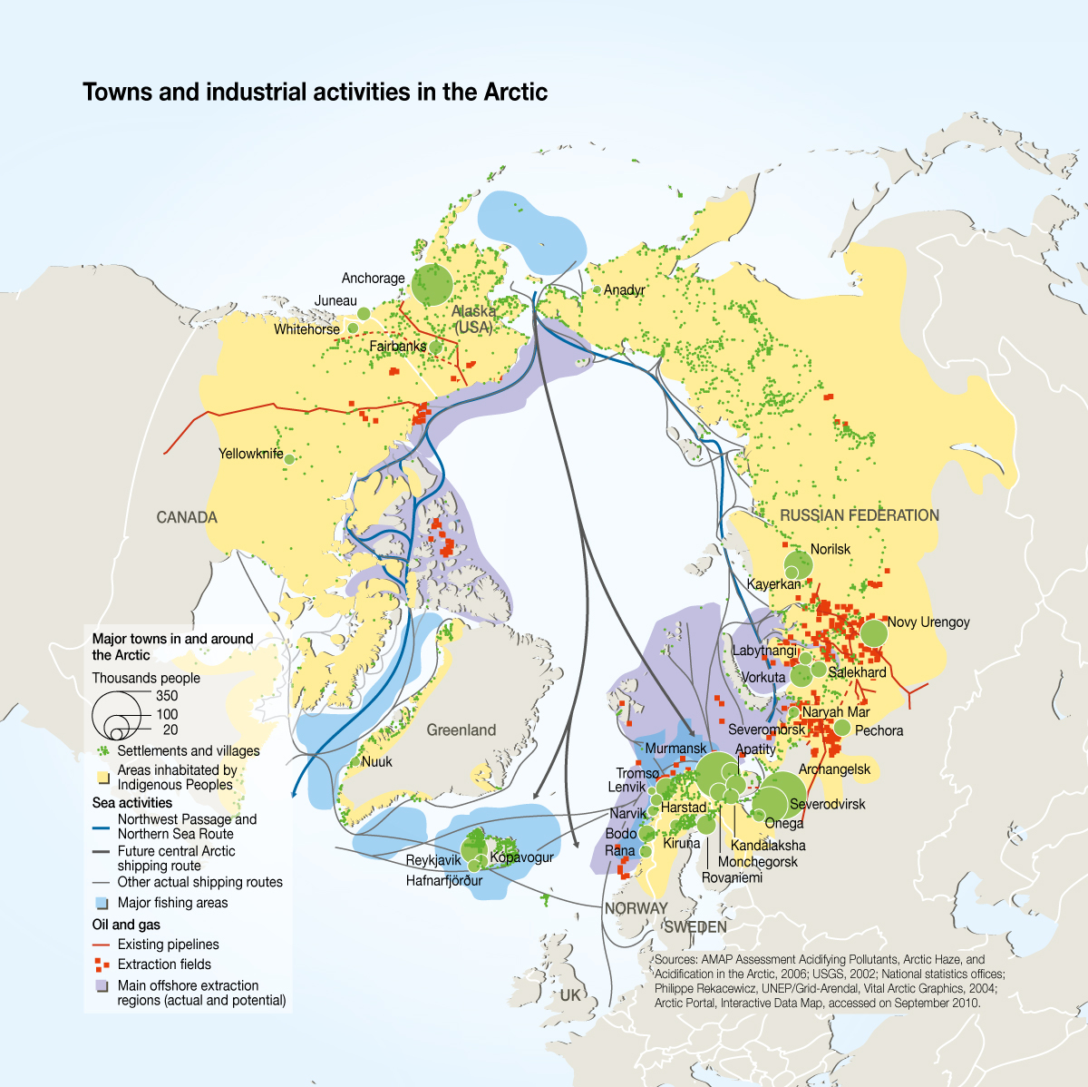

Slide 4
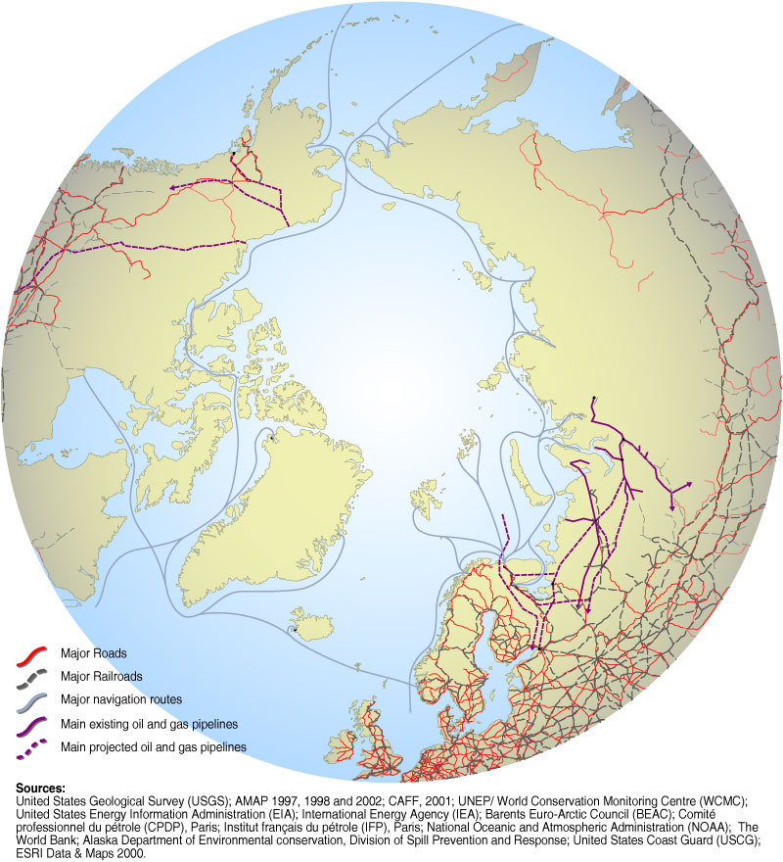
Arctic Transportation Routes
Dutch Harbor
Greenland :
  Thule Air Force Base (US), northern most Deepwater port
  21 smaller ports on the West Coast of Greenland
Iceland:
  Reydarfjordur
  Reykjavik
Norway:
  Bergen
  Tromso
  Oslo
  Stravanger
Russia:
  Murmansk
  Arkhangelsk
  Tiksi
  Provideniya
  11 smaller ports along the Northern Sea Route
United States: Dutch Harbor
Canada:
  Tuktoyaktuk
  Churchhill
  Nanisivik
  Iqaluit
  Argentia
Dillingham
Nome
Providenya
Anadyr
Kotzebue
Prudhoe Bay
Tuktoyaktuk
Tiksi
Churchhill
Hatanga
Thule AFB
Amderma
Nuuk, Greenland
Murmansk
Arkhangelsk
Tromso
Reykjavik & Reydarfjordur, Iceland
Bergen
Stravanger
“Airports” -There are approx 20 airports located at or above 64 degrees latitude, circumpolar.

Slide 5
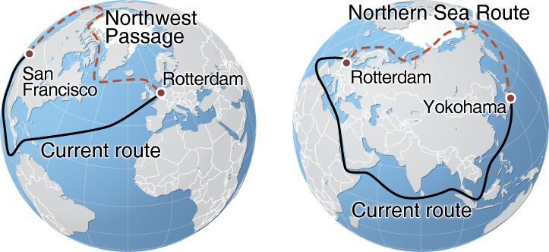
Comparative Shipping Routes
From Rotterdam to:
Yokohama: 20,600 km (Suez Canal); 8,500 km (Northeast Passage)
Shanghai: 19,300 km (Suez Canal); 14,875 km (Northeast Passage)
Vancouver: 16,400 km (Panama Canal); 12,850 km (Northeast Passage)

Slide 6
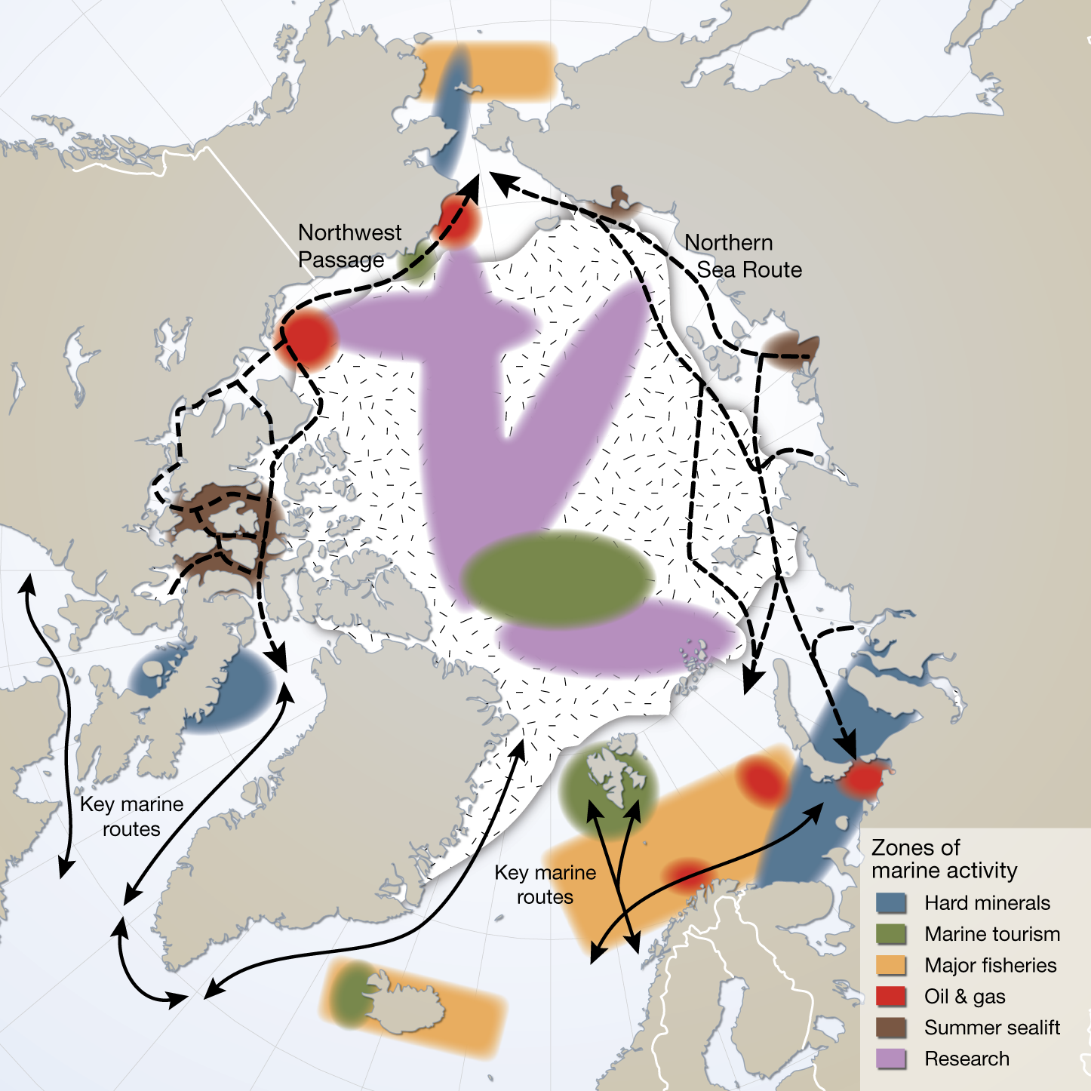
Current Shipping Use

Slide 7
Map References
Towns and industrial activities in the Arctic. (2010). In UNEP/GRID-Arendal Maps and Graphics Library. Retrieved 00:02, September 5, 2011 from http://maps.grida.no/go/graphic/towns-and-industrial-activities-in-the-arctic.
Arctic transportation routes - roads, shipping and pipelines. (2007). InUNEP/GRID-Arendal Maps and Graphics Library. Retrieved 00:23, September 5, 2011 from http://maps.grida.no/go/graphic/arctic-transportation-routes-roads-shipping-and-pipelines.
Northern Sea Route and the Northwest Passage compared with currently used shipping routes. (June 2007). In UNEP/GRID-Arendal Maps and Graphics Library. Retrieved 00:25, September 5, 2011 fromhttp://maps.grida.no/go/graphic/northern-sea-route-and-the-northwest-passage-compared-with-currently-used-shipping-routes.
Current marine shipping uses in the Arctic. (May 2010). In UNEP/GRID-Arendal Maps and Graphics Library. Retrieved 00:12, September 5, 2011 from http://maps.grida.no/go/graphic/current-marine-shipping-uses-in-the-arctic.
ArcticImperative.com
alice@alaskadispatch.com or megan@arcticimperative.com

